Slide 1

Exploring and translating the female genital tract microbiota
Jacques Ravel, PhD
Professor of Microbiology and Immunology
Institute for Genome Sciences
University of Maryland School of Medicine
jravel@som.umaryland.edu
Durban, South Africa
April 26, 2024

Slide 2


Who am I?
Professor of Microbiology and Immunology, and the Acting Director of the Institute for Genome Sciences at the University of Maryland School of Medicine in Baltimore, Maryland, USA
Lead a laboratory that aims to improve women’s health conditions by optimizing the composition and functions of the vaginal microbiome
Apply genomics approaches to clinical samples, develop bioinformatic tools, test hypothesis and translate findings into innovative interventions

Slide 3
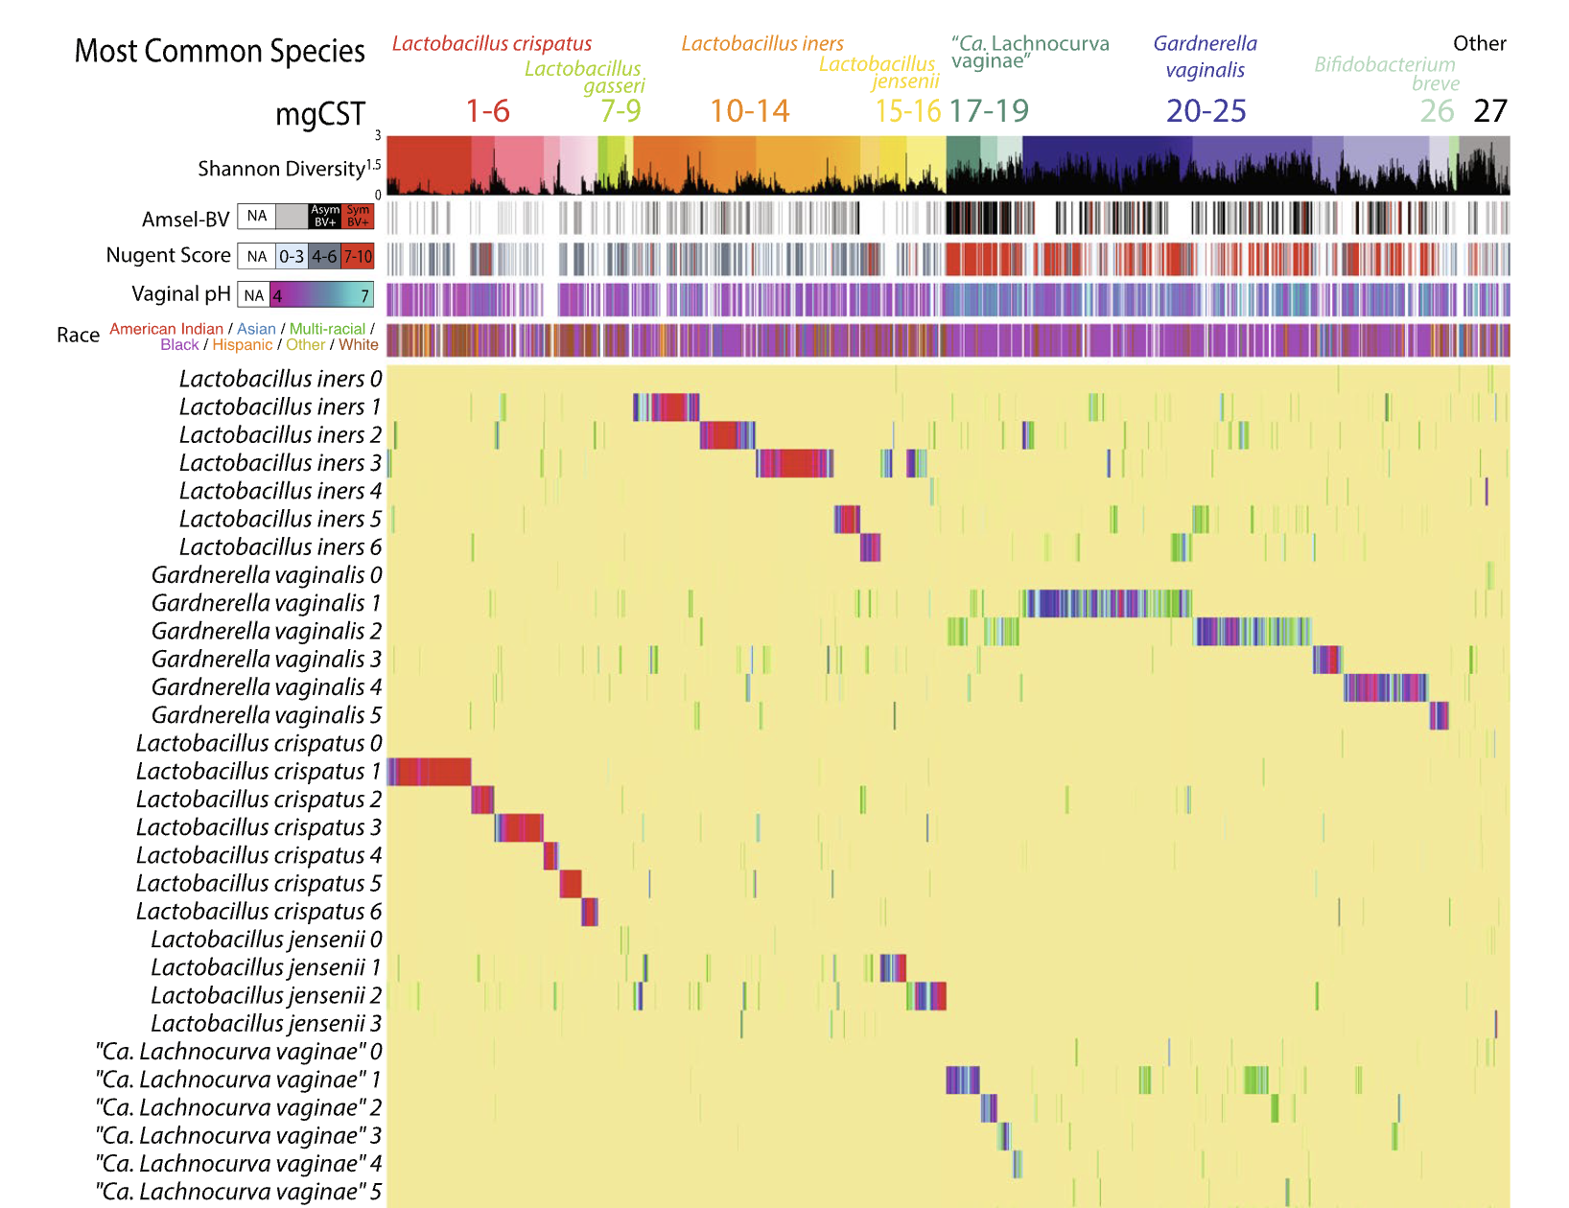
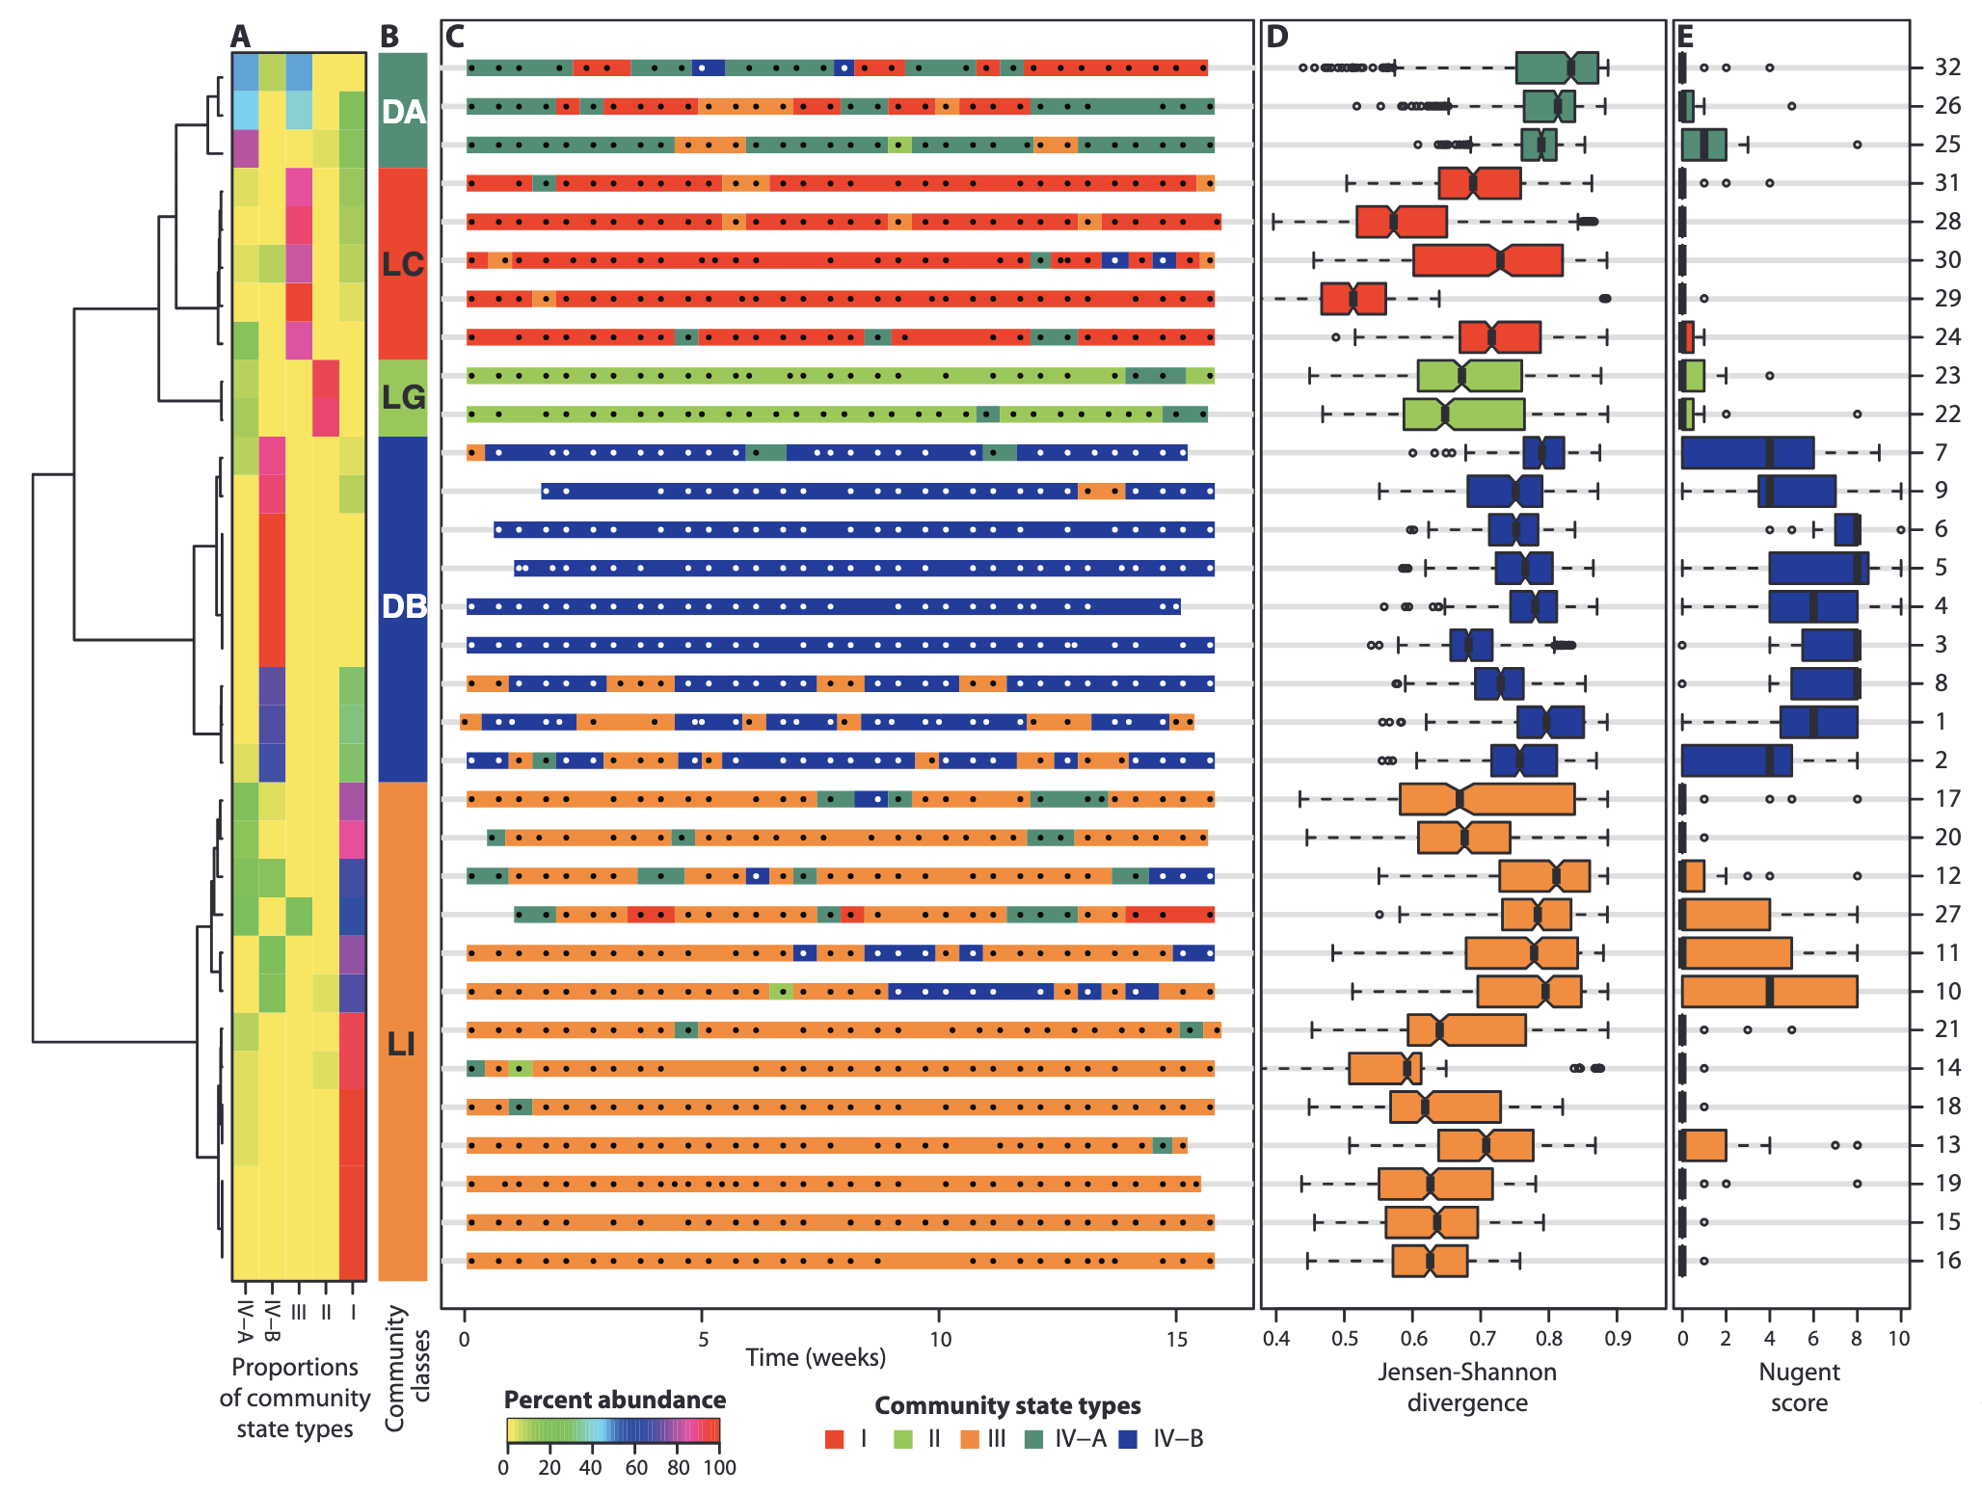

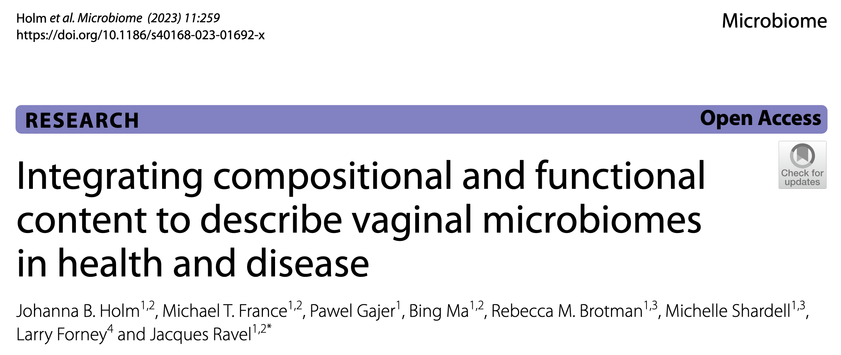
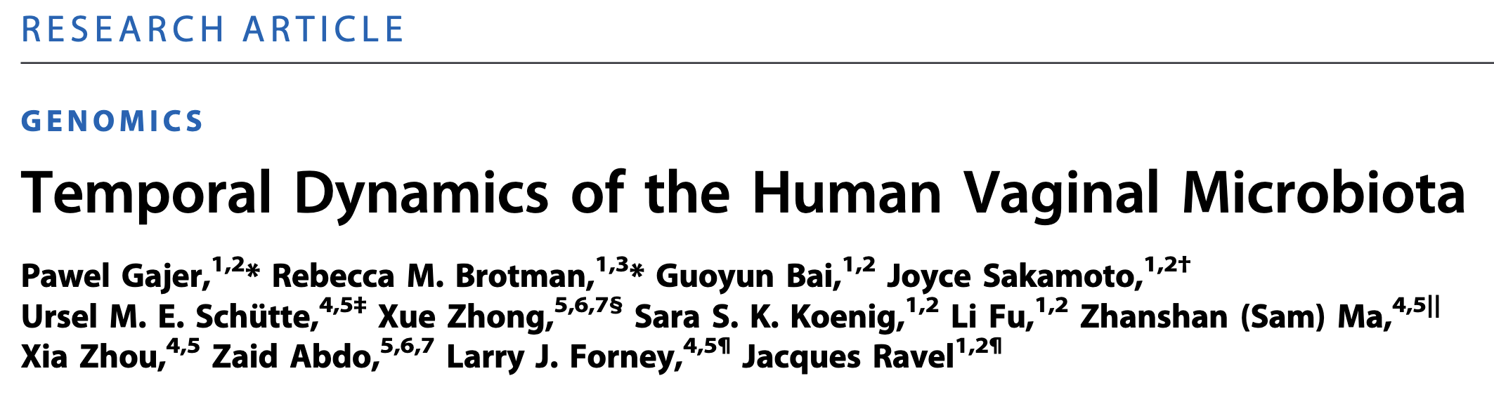
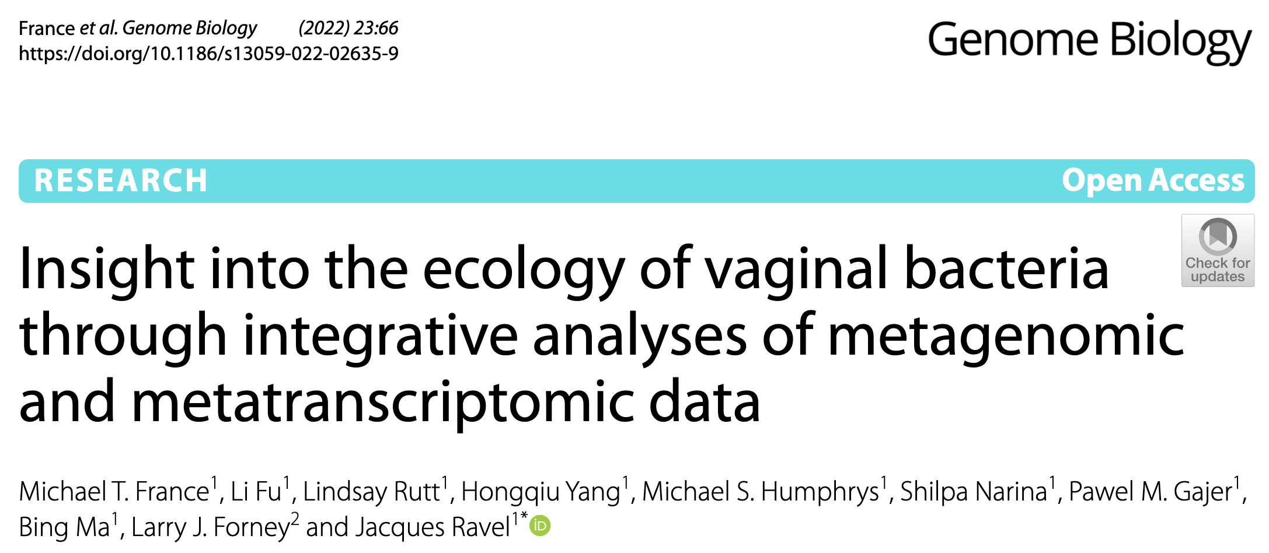
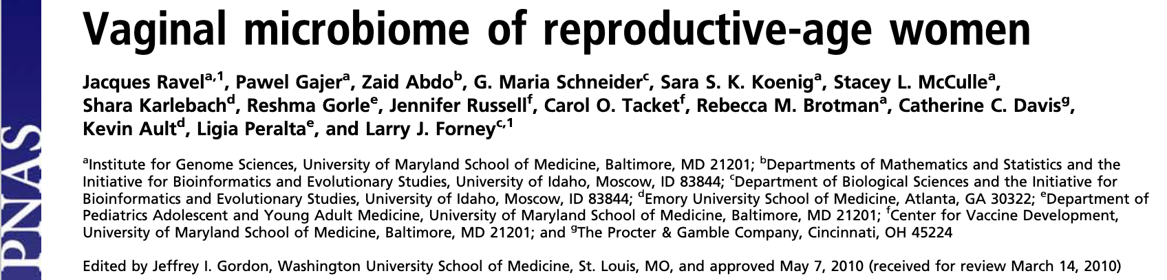
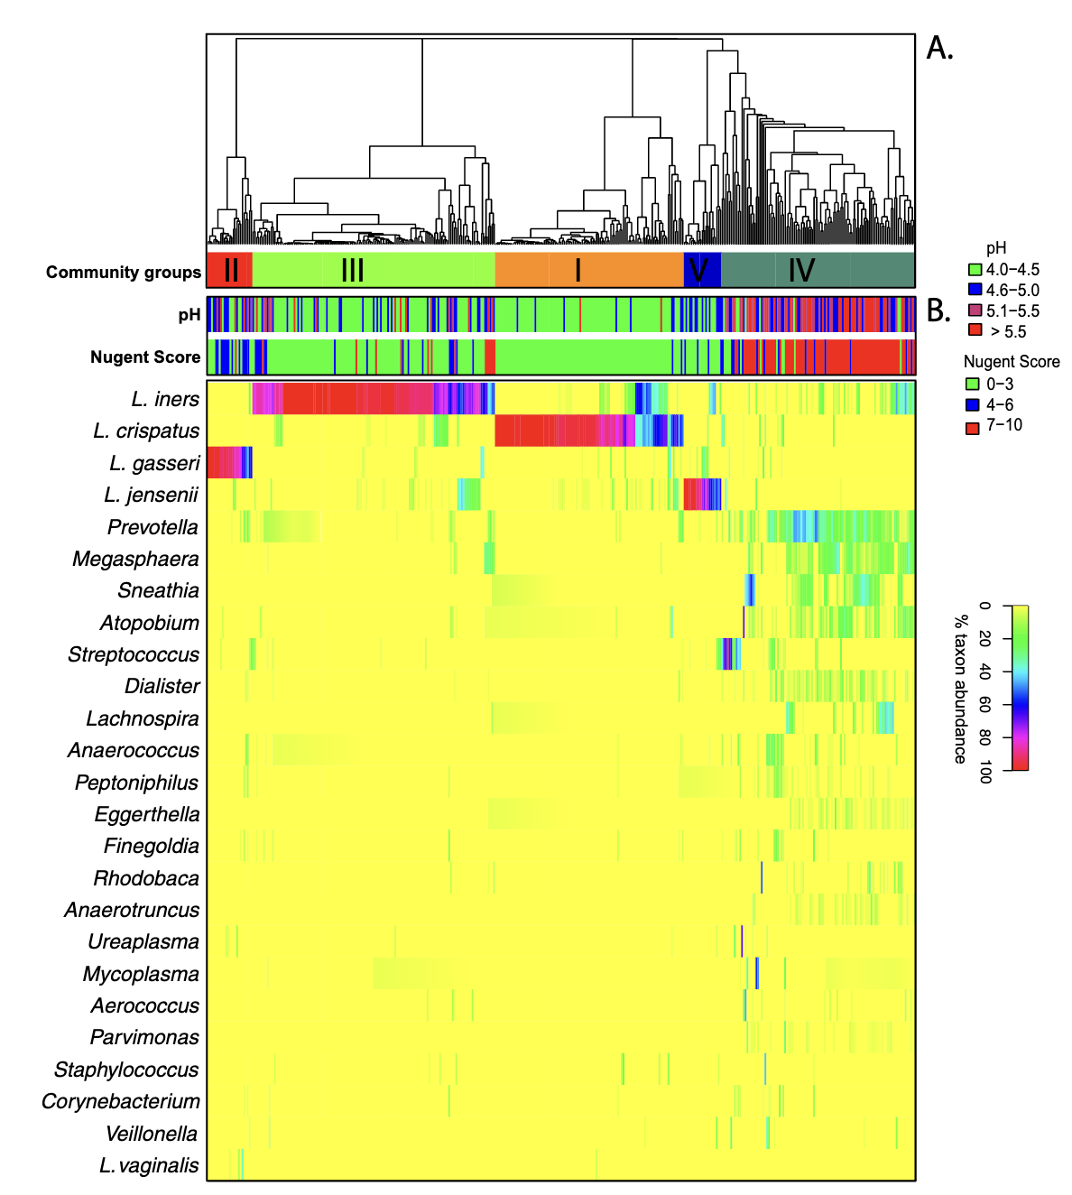
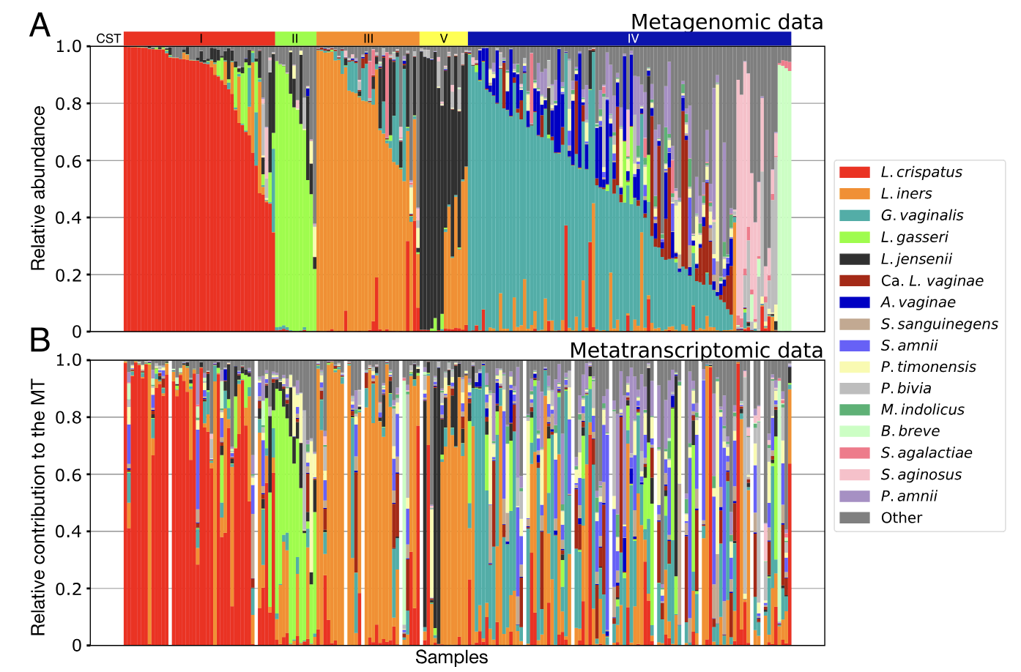
Who am I?
Postdoctoral Fellowship
Natural Product Chemistry
Johns Hopkins University
Associate Professor
Microbiology & Immunology
University of Maryland School of Medicine
Master Degree
Vibrio cholerae ecology
2022
1990
1999
2002
2006
2009
2011
2022
1992
2002
2007
Human Microbiome Project (HMP)
2012
2023
NIH grant
Vaginal microbiome
Bachelor Degree
Microbiology and Molecular Biology
University Nancy - France
Assistant Investigator
The Institute for Genomic Research (TIGR)
PhD in Microbial Molecular Ecology
Marine Streptomyces
University of Maryland

Slide 4

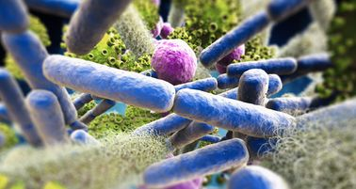

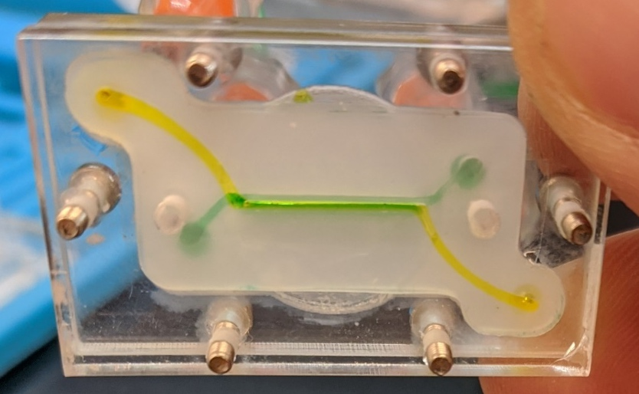
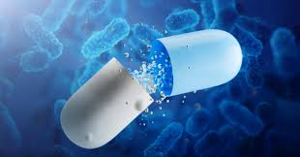
Transformative Bench to Bed-Side Research in Women’s Health
3D Biomimetic Models
Live Biotherapeutics Products
Microbiome Research
Data Analytical Tools
• Multi-omics Analyses
• Laboratory Methods
• Bacterial Vaginosis
• Preterm Birth
• STIs
• Menopause
• Transgender
• SpeciateIT
• VALENCIA
• VIRGO
• RLLM
• Modeling vaginal and cervical epithelia
• Include Microbiome
• Study host-microbiome interactions and STIs
• Innovative Formulation
• In-human clinical trial to prevent bacterial vaginosis recurrence

Slide 5
The vaginal microbiome
In reproductive age women, high abundance of Lactobacillus spp. are often characteristic of an optimal vaginal microbiota. A feature unique to human as no other mammals carry Lactobacillus spp.
Lactobacillus spp. are lactic acid producers and acidify the vagina to pH < 4
An acidic environment is thought to restrict the growth of non-indigenous microbes
Changing environment throughout a women’s lifespan - microbiota changes accordingly

Slide 6
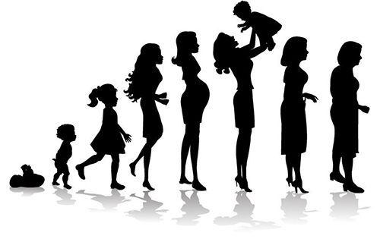
The vaginal microbiota through the lifespan
Birth
Pre-menarche
Menarche
Reproductive Years
Menopause
Lactobacillus
Estrogen

Slide 7
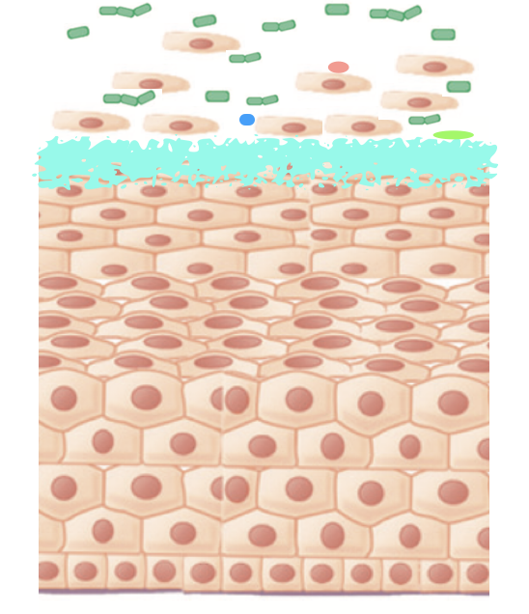
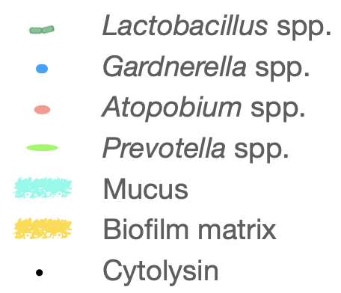
Estrogen and epithelial cell maturation
Glycogen
Sugars
Estrogen

Slide 8
The vaginal microbiota through the lifespan
Birth
Pre-menarche
Menarche
Reproductive Years
Menopause
Lactobacillus
Estrogen

Slide 9
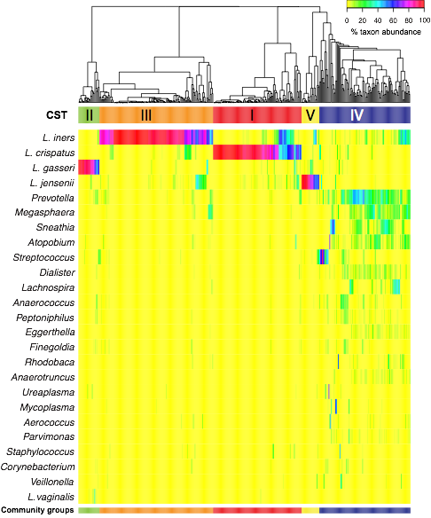
The vaginal microbiota composition and structure
A study of 400 women of reproductive age representing 4 ethnic background – one sample per women
Five broad community state types (CST) that differ in their microbial composition and abundance, some of them dominated by Lactobacillus spp. and considered optimal.
CST IV lack significant number of Lactobacillus - higher diversity. Non-optimal and associated with adverse outcomes.
Ravel et al.. PNAS 2011

Slide 10

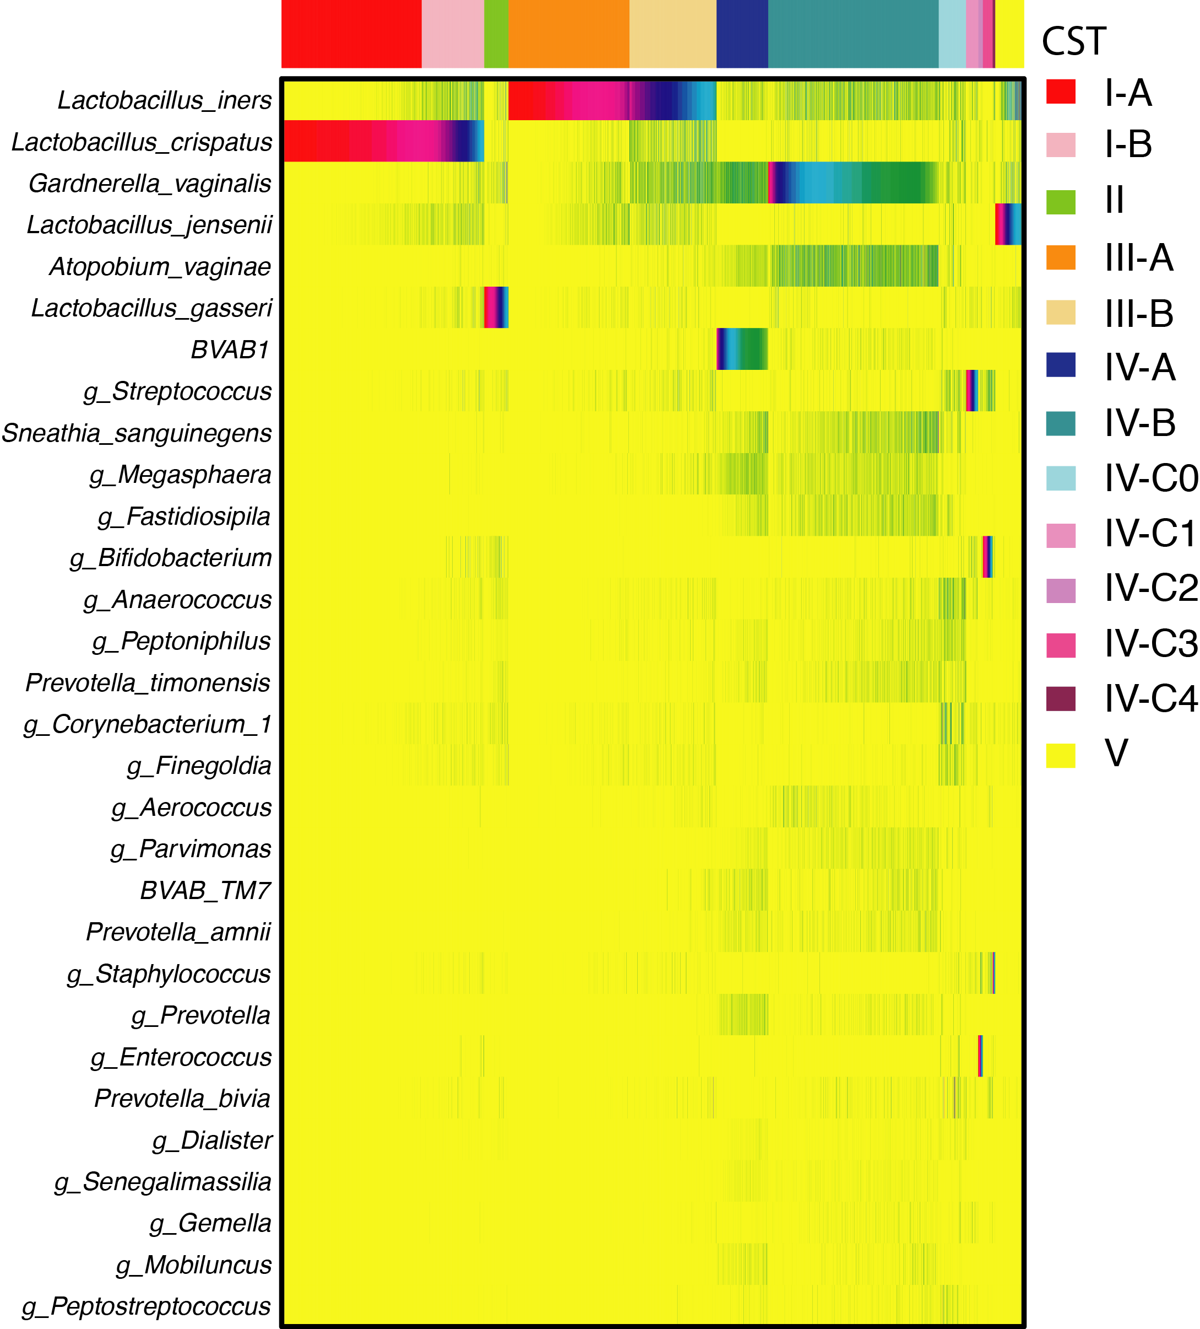
Vaginal community composition and structure
Composition of the vaginal microbiota from 13,000 samples (16S rRNA gene V3-V4 regions)
I
II
III
IV
V
I-A
I-B
II
III-A
III-B
IV-A
IV-B
IV-C
V
I-A
I-B
II
III-A
III-B
IV-A
IV-B
IV-C0
IV-C1
IV-C2
IV-C3
IV-C4
V
Streptococcus
Bifidobacterium
Enterococcus
Staphylococcus
France M et al. Microbiome. 2020

Slide 11
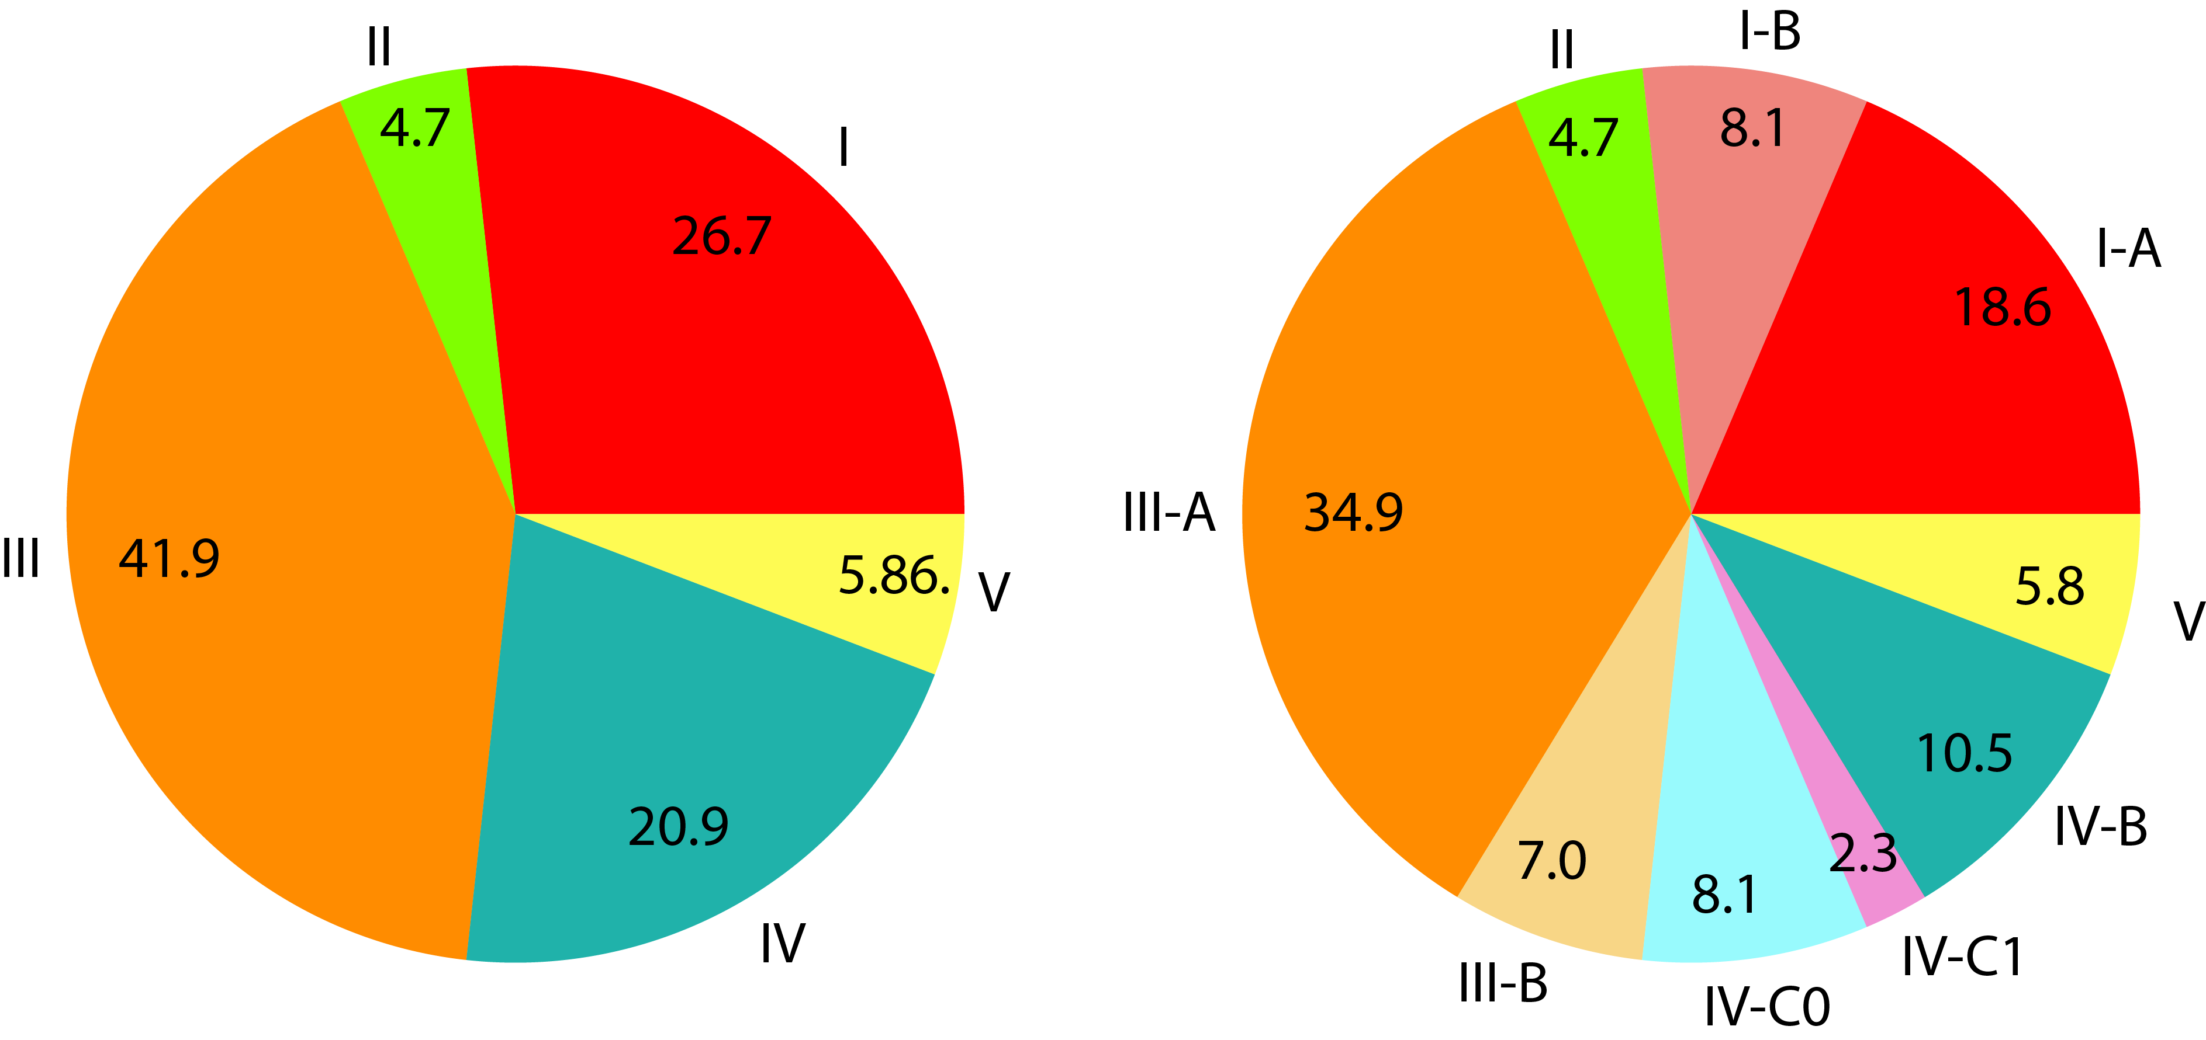
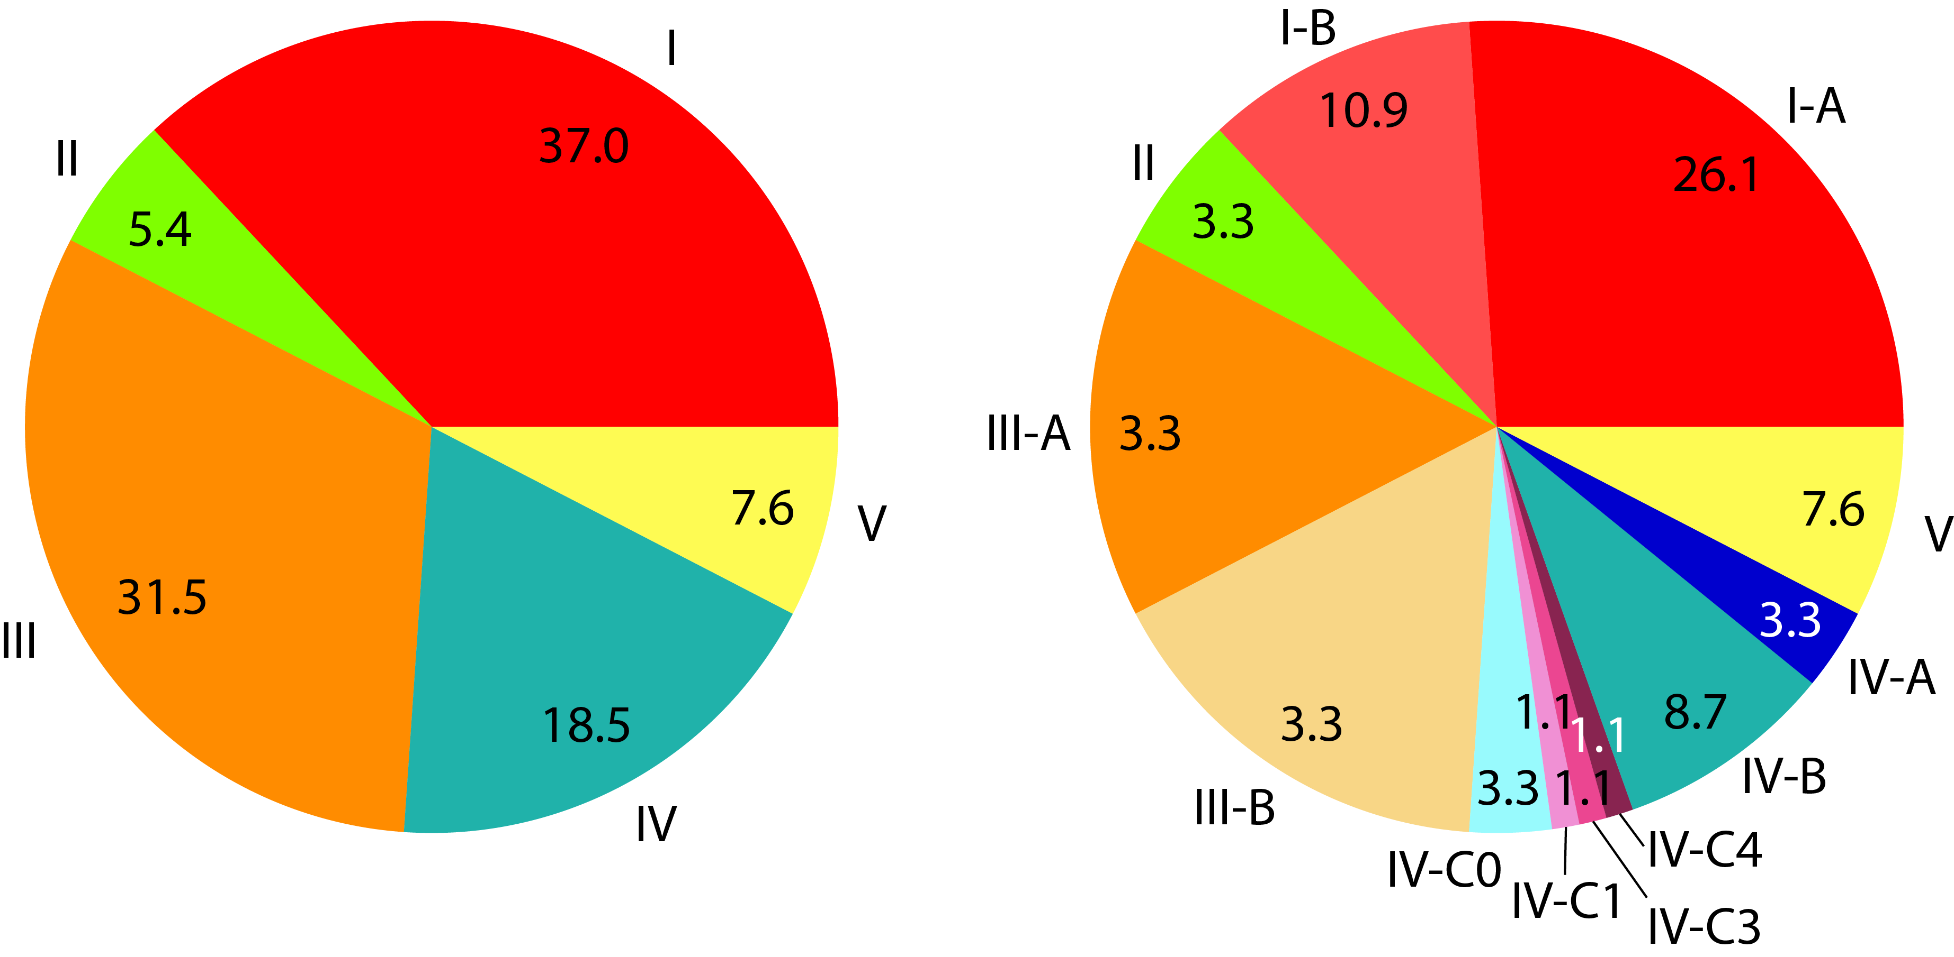
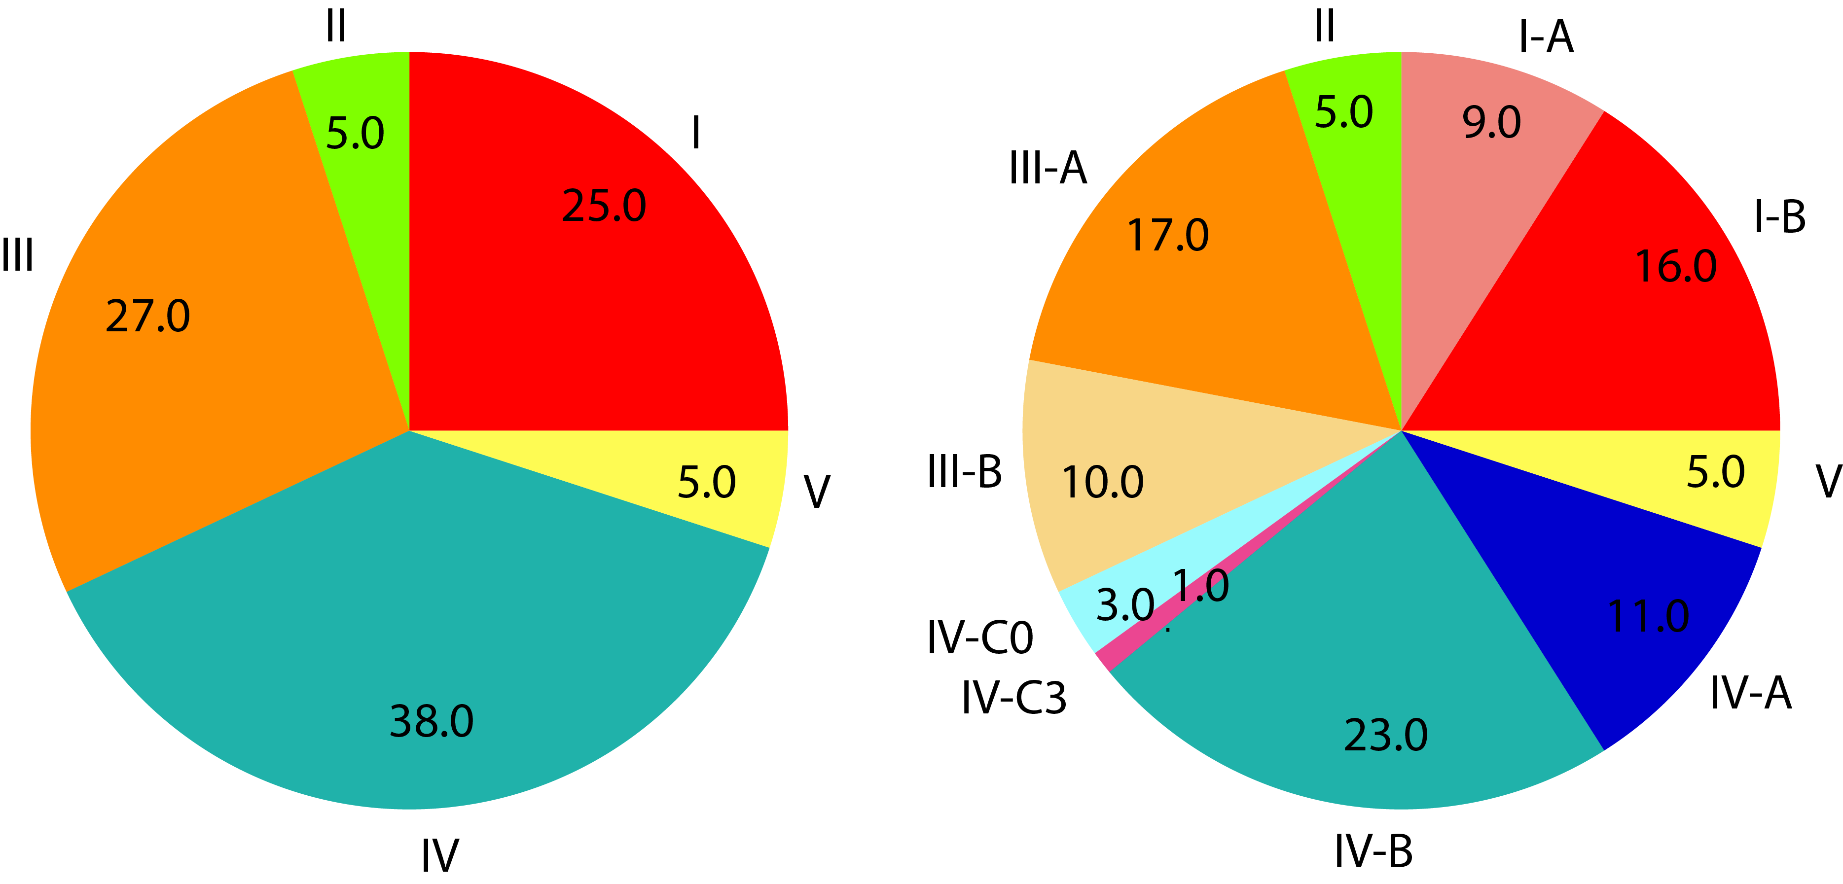
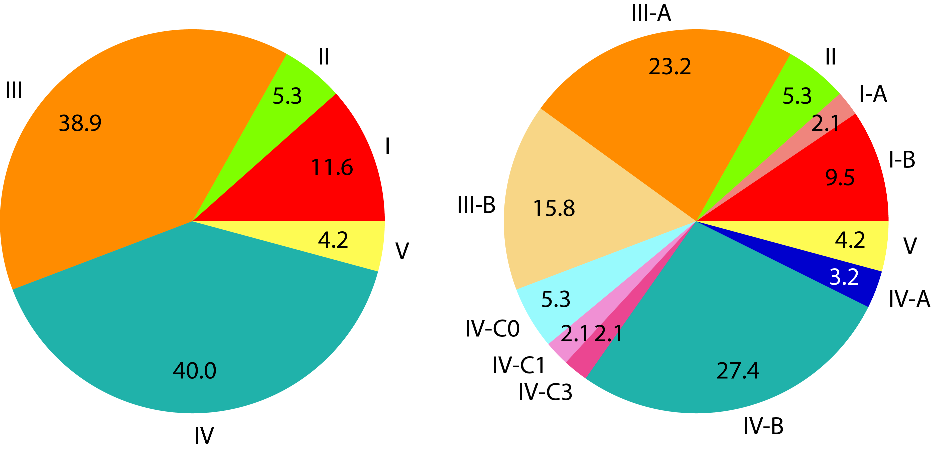
Frequency of vaginal community state types in ethnic groups
Asian
Caucasian
Hispanic
Black
Ravel et al. The vaginal microbiome of reproductive age women. PNAS. 2011. 108 Suppl 1, 4680–4687.

Slide 12
Frequency of vaginal community state types in ethnic groups
Asian
Caucasian
Hispanic
Black
Ravel et al. The vaginal microbiome of reproductive age women. PNAS. 2011. 108 Suppl 1, 4680–4687.

Slide 13
The dynamics of the vaginal microbiota
Clinical study of 160 women who collected daily samples for 10 weeks
Daily dairies used to collect relevant metadata, including hygiene, sexual practices among others
Characterize the composition of the vaginal microbiota using 16S rRNA gene sequencing
Several types of longitudinal profiles were obtained

Slide 14
The dynamics of the vaginal microbiota

Slide 15
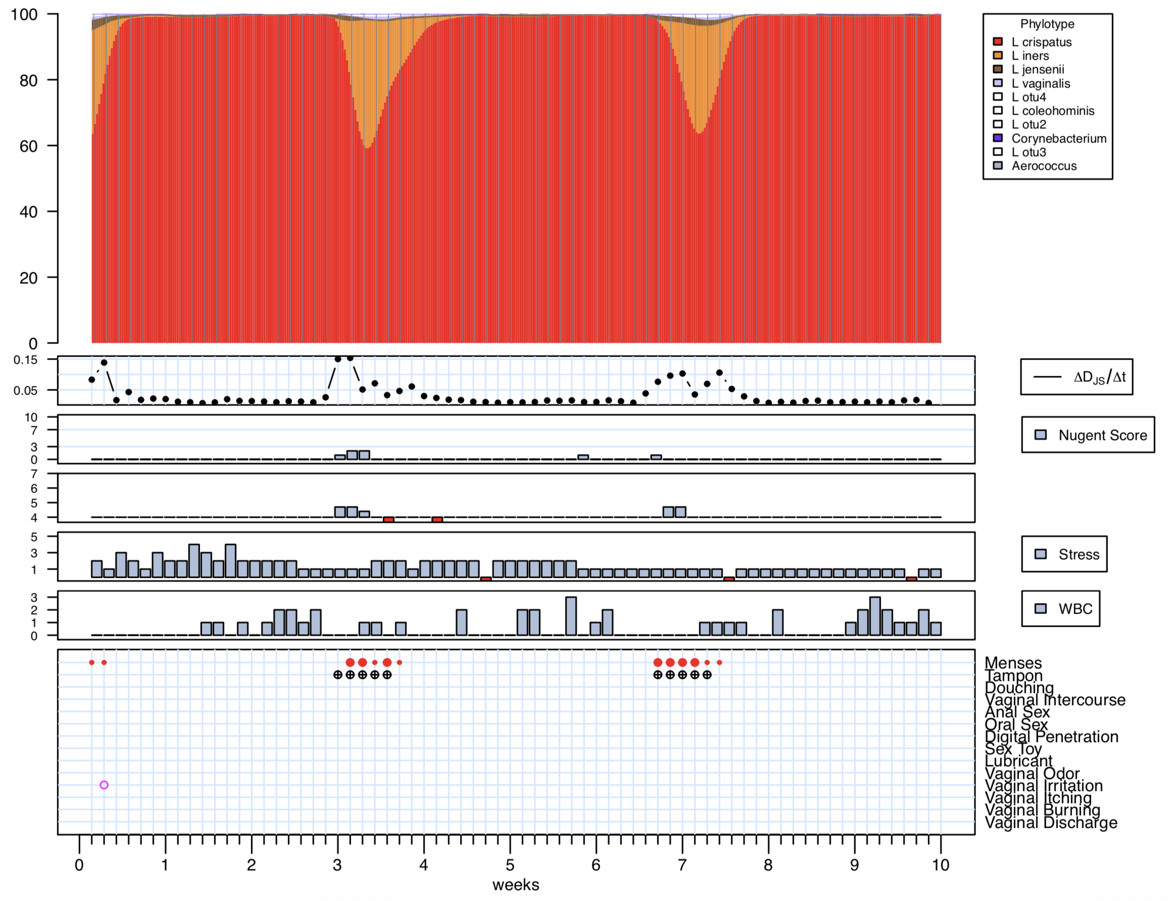
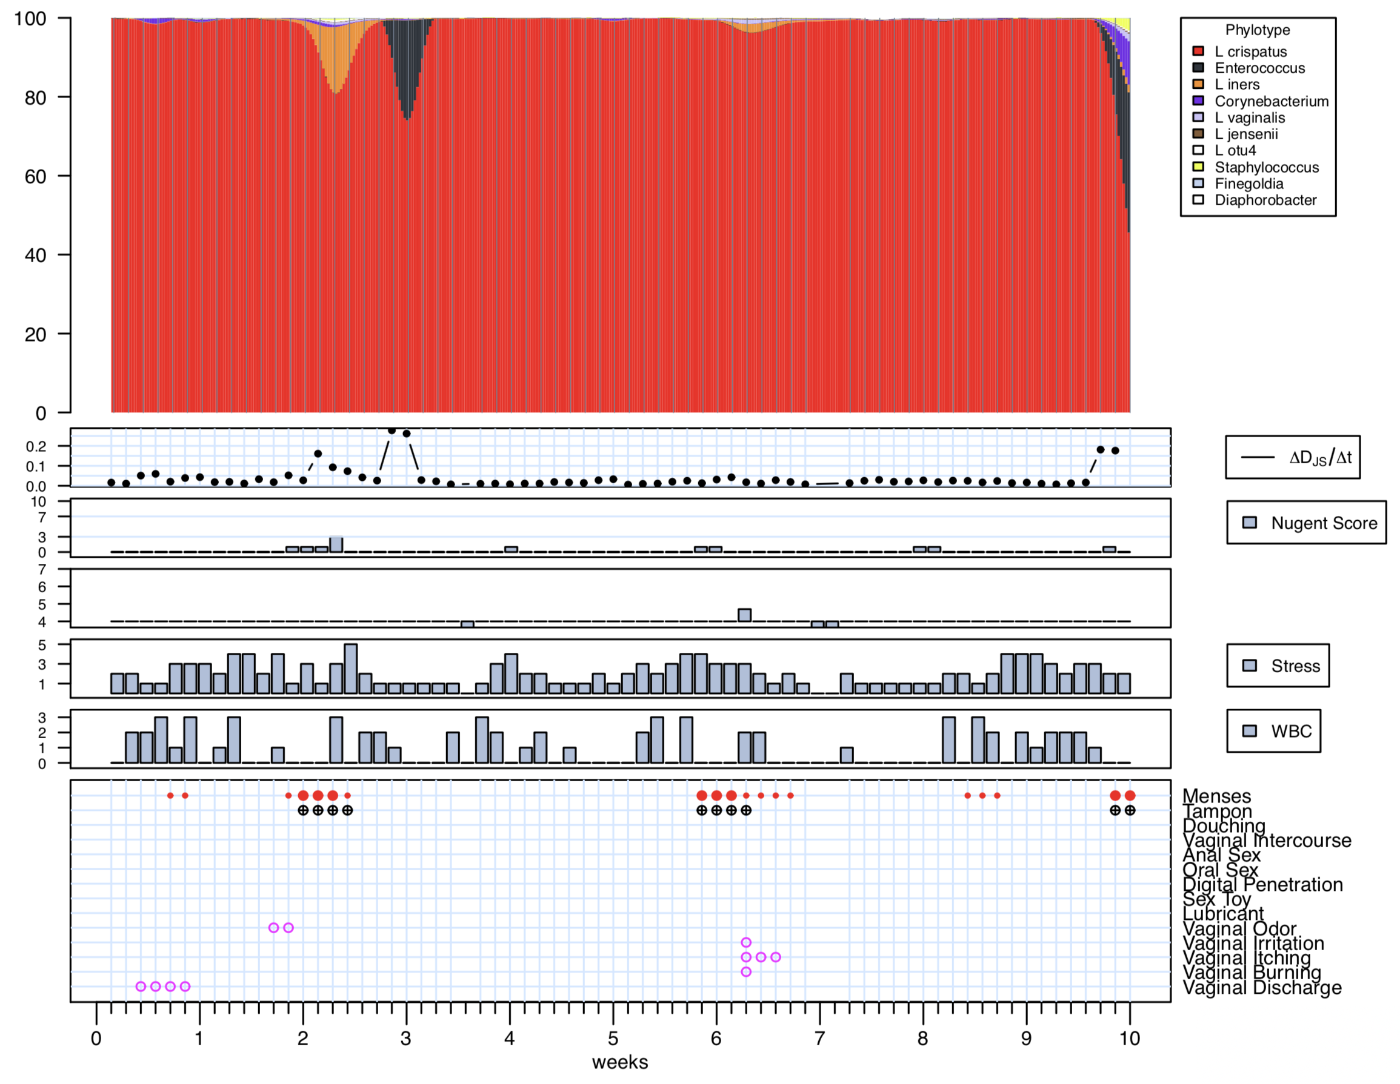
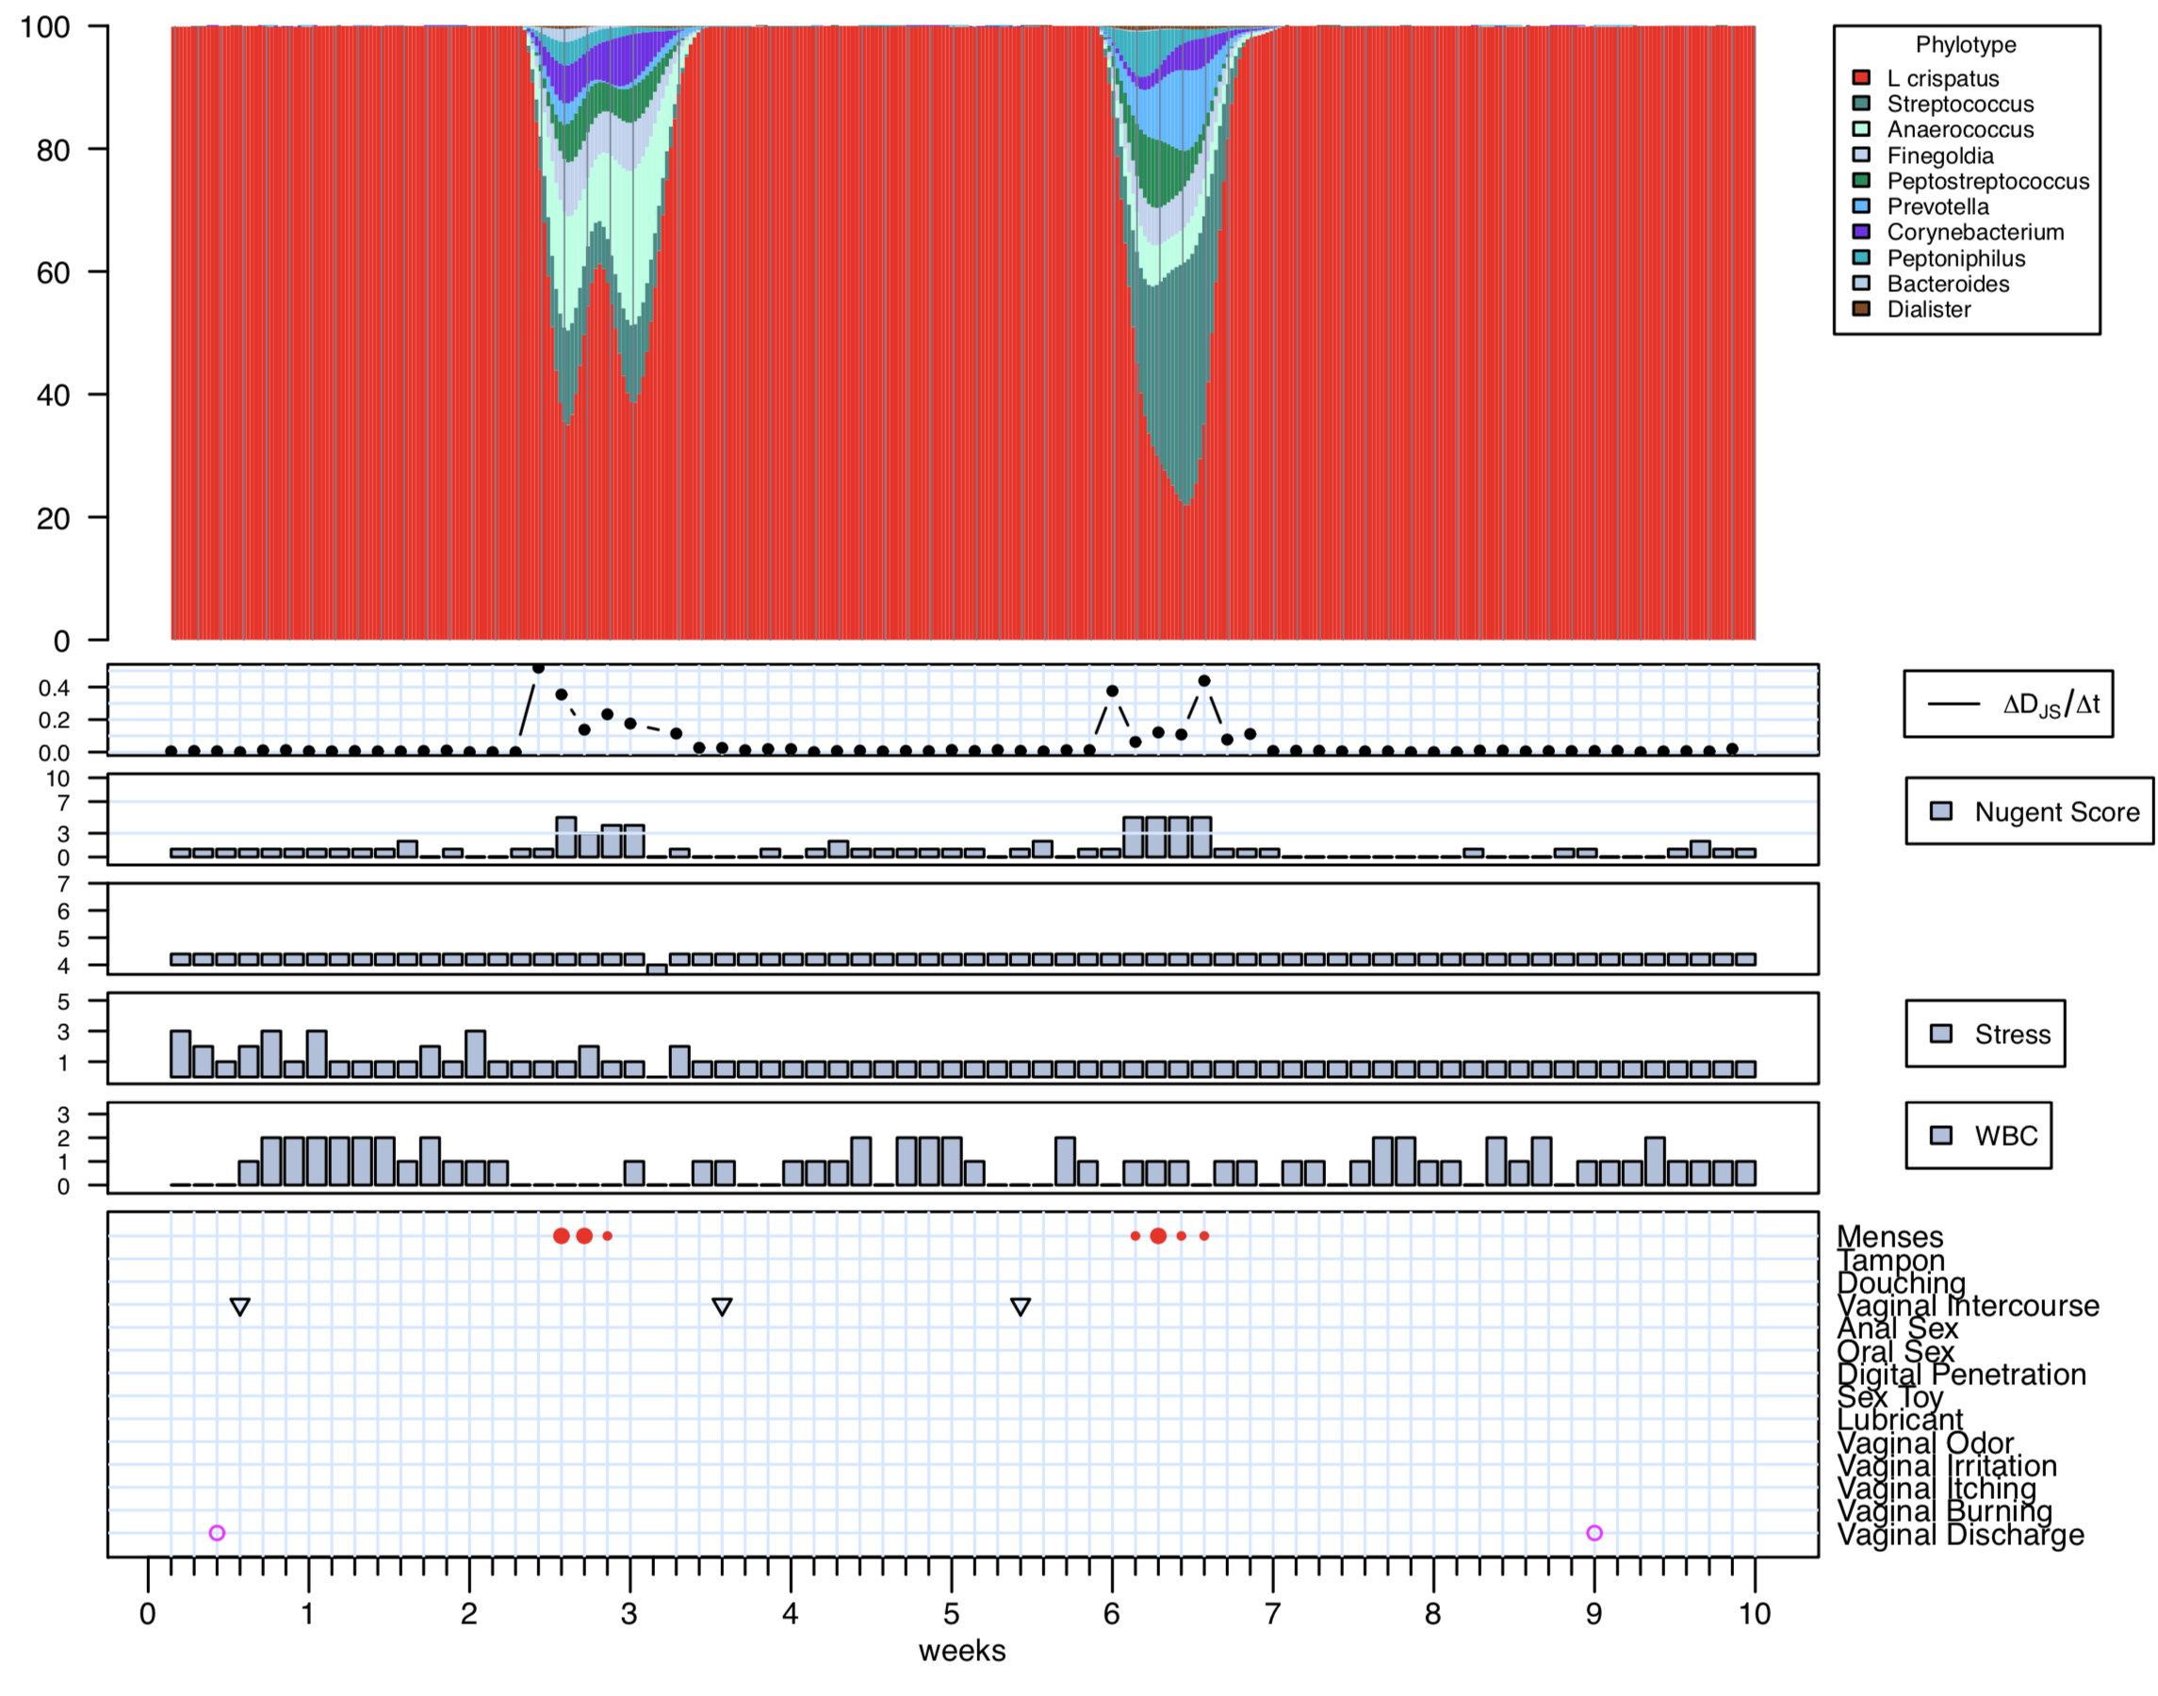
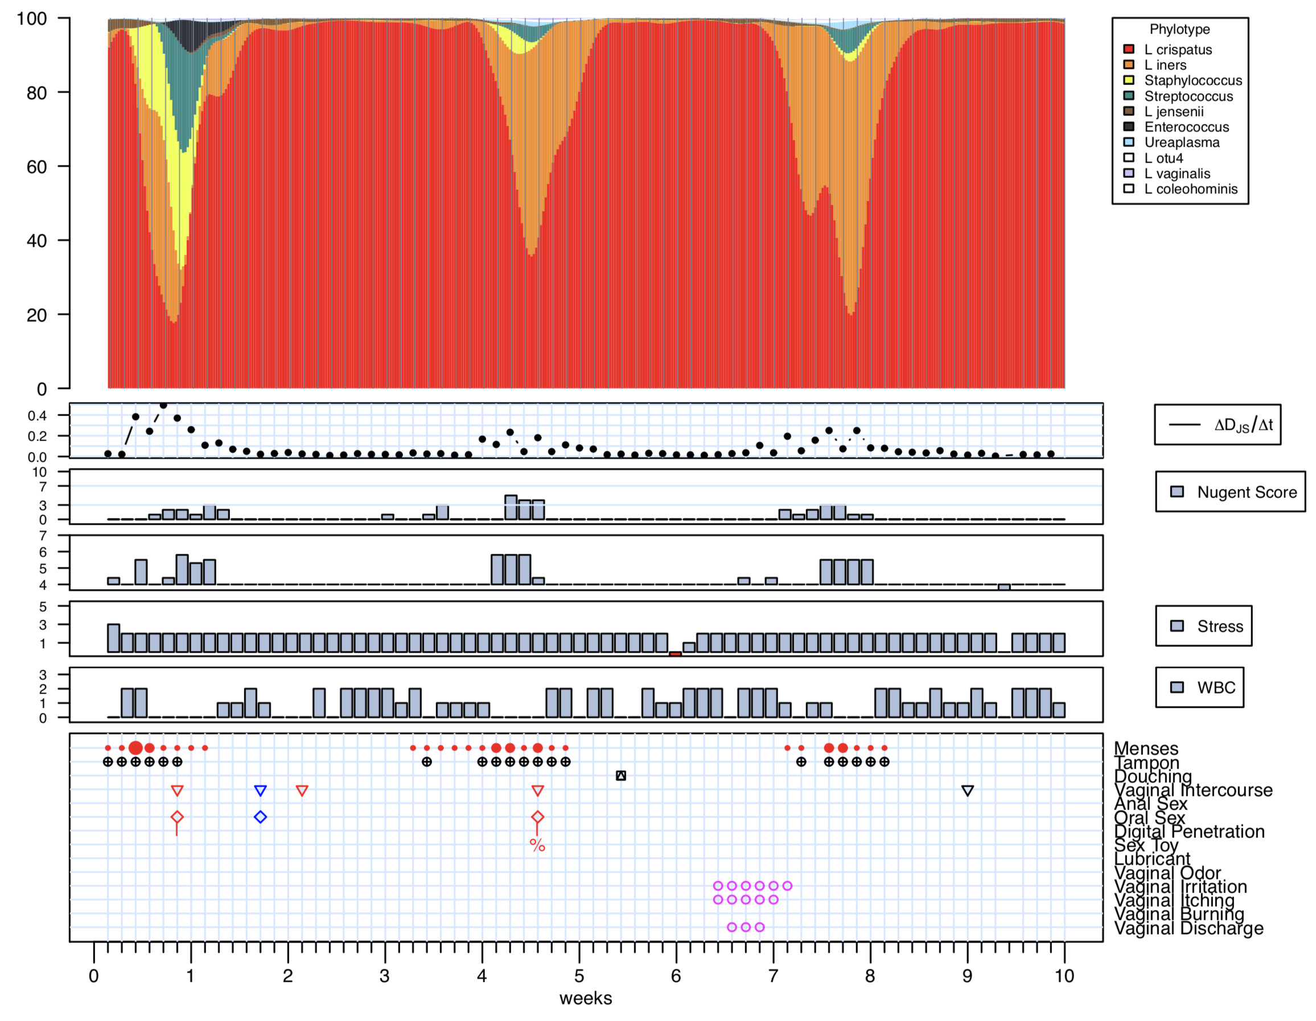
The dynamics of the vaginal microbiota

Slide 16
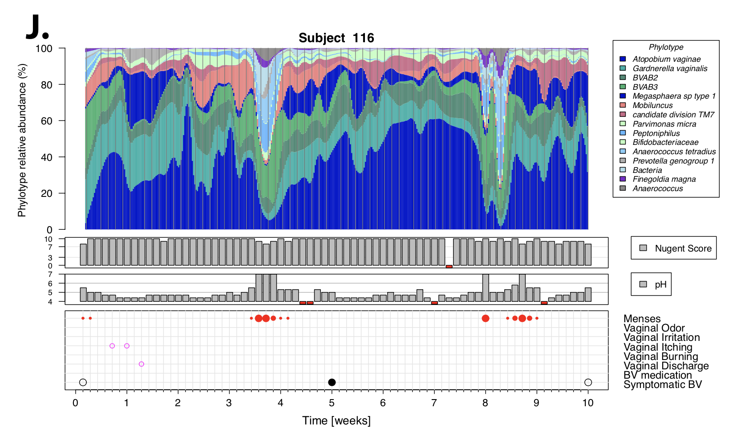
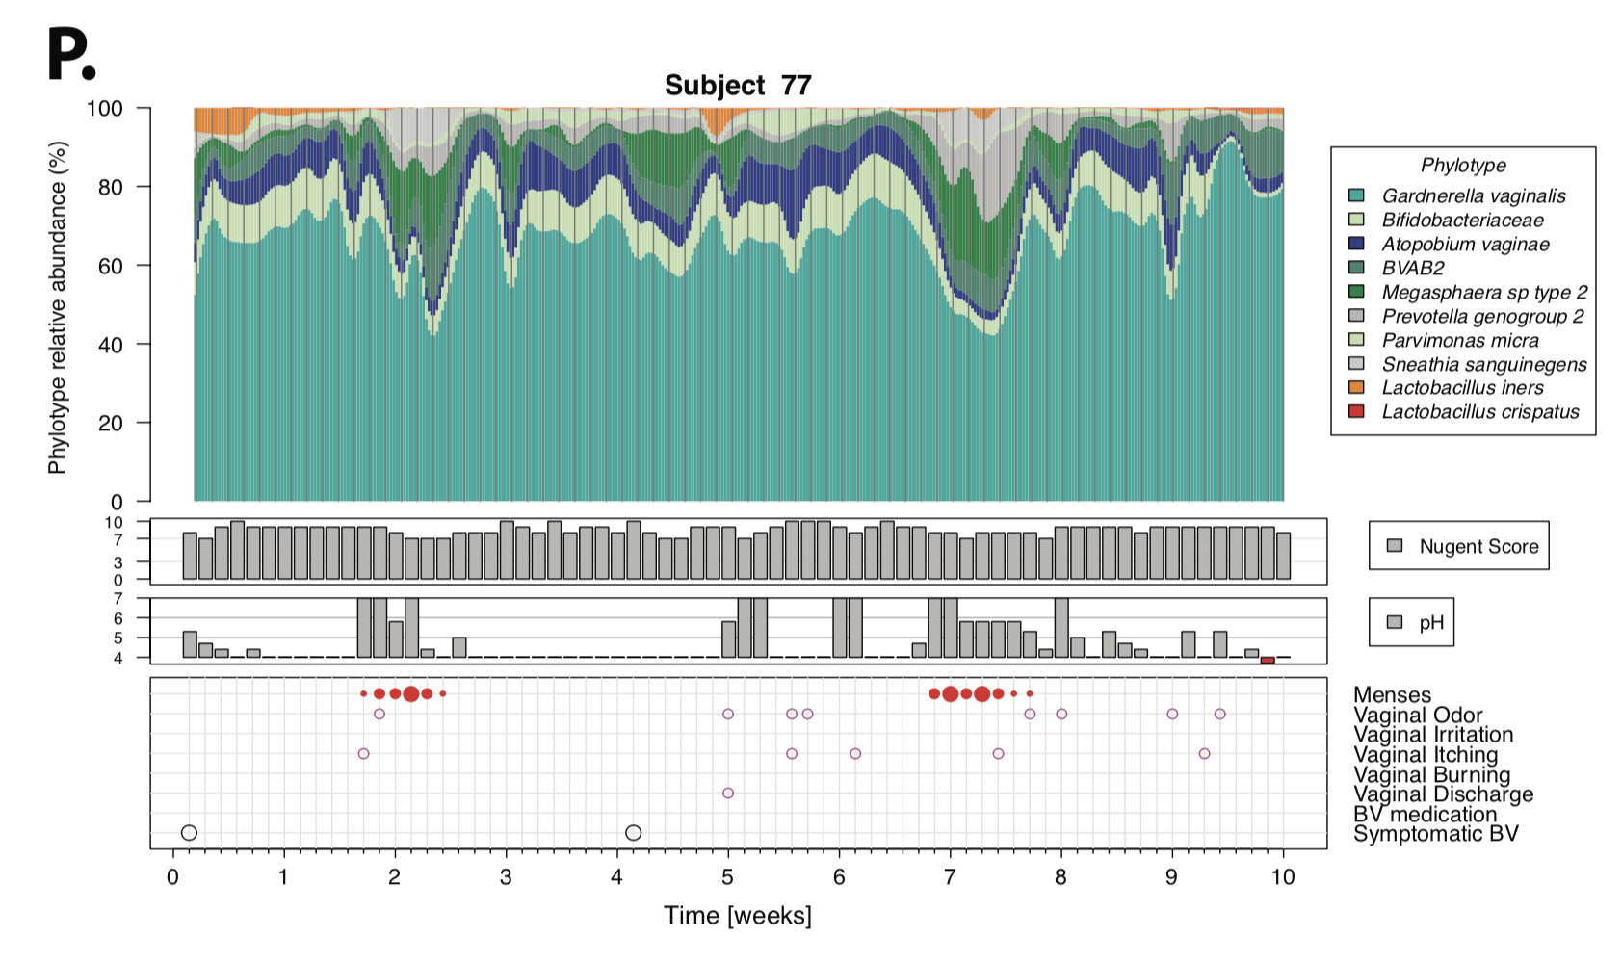
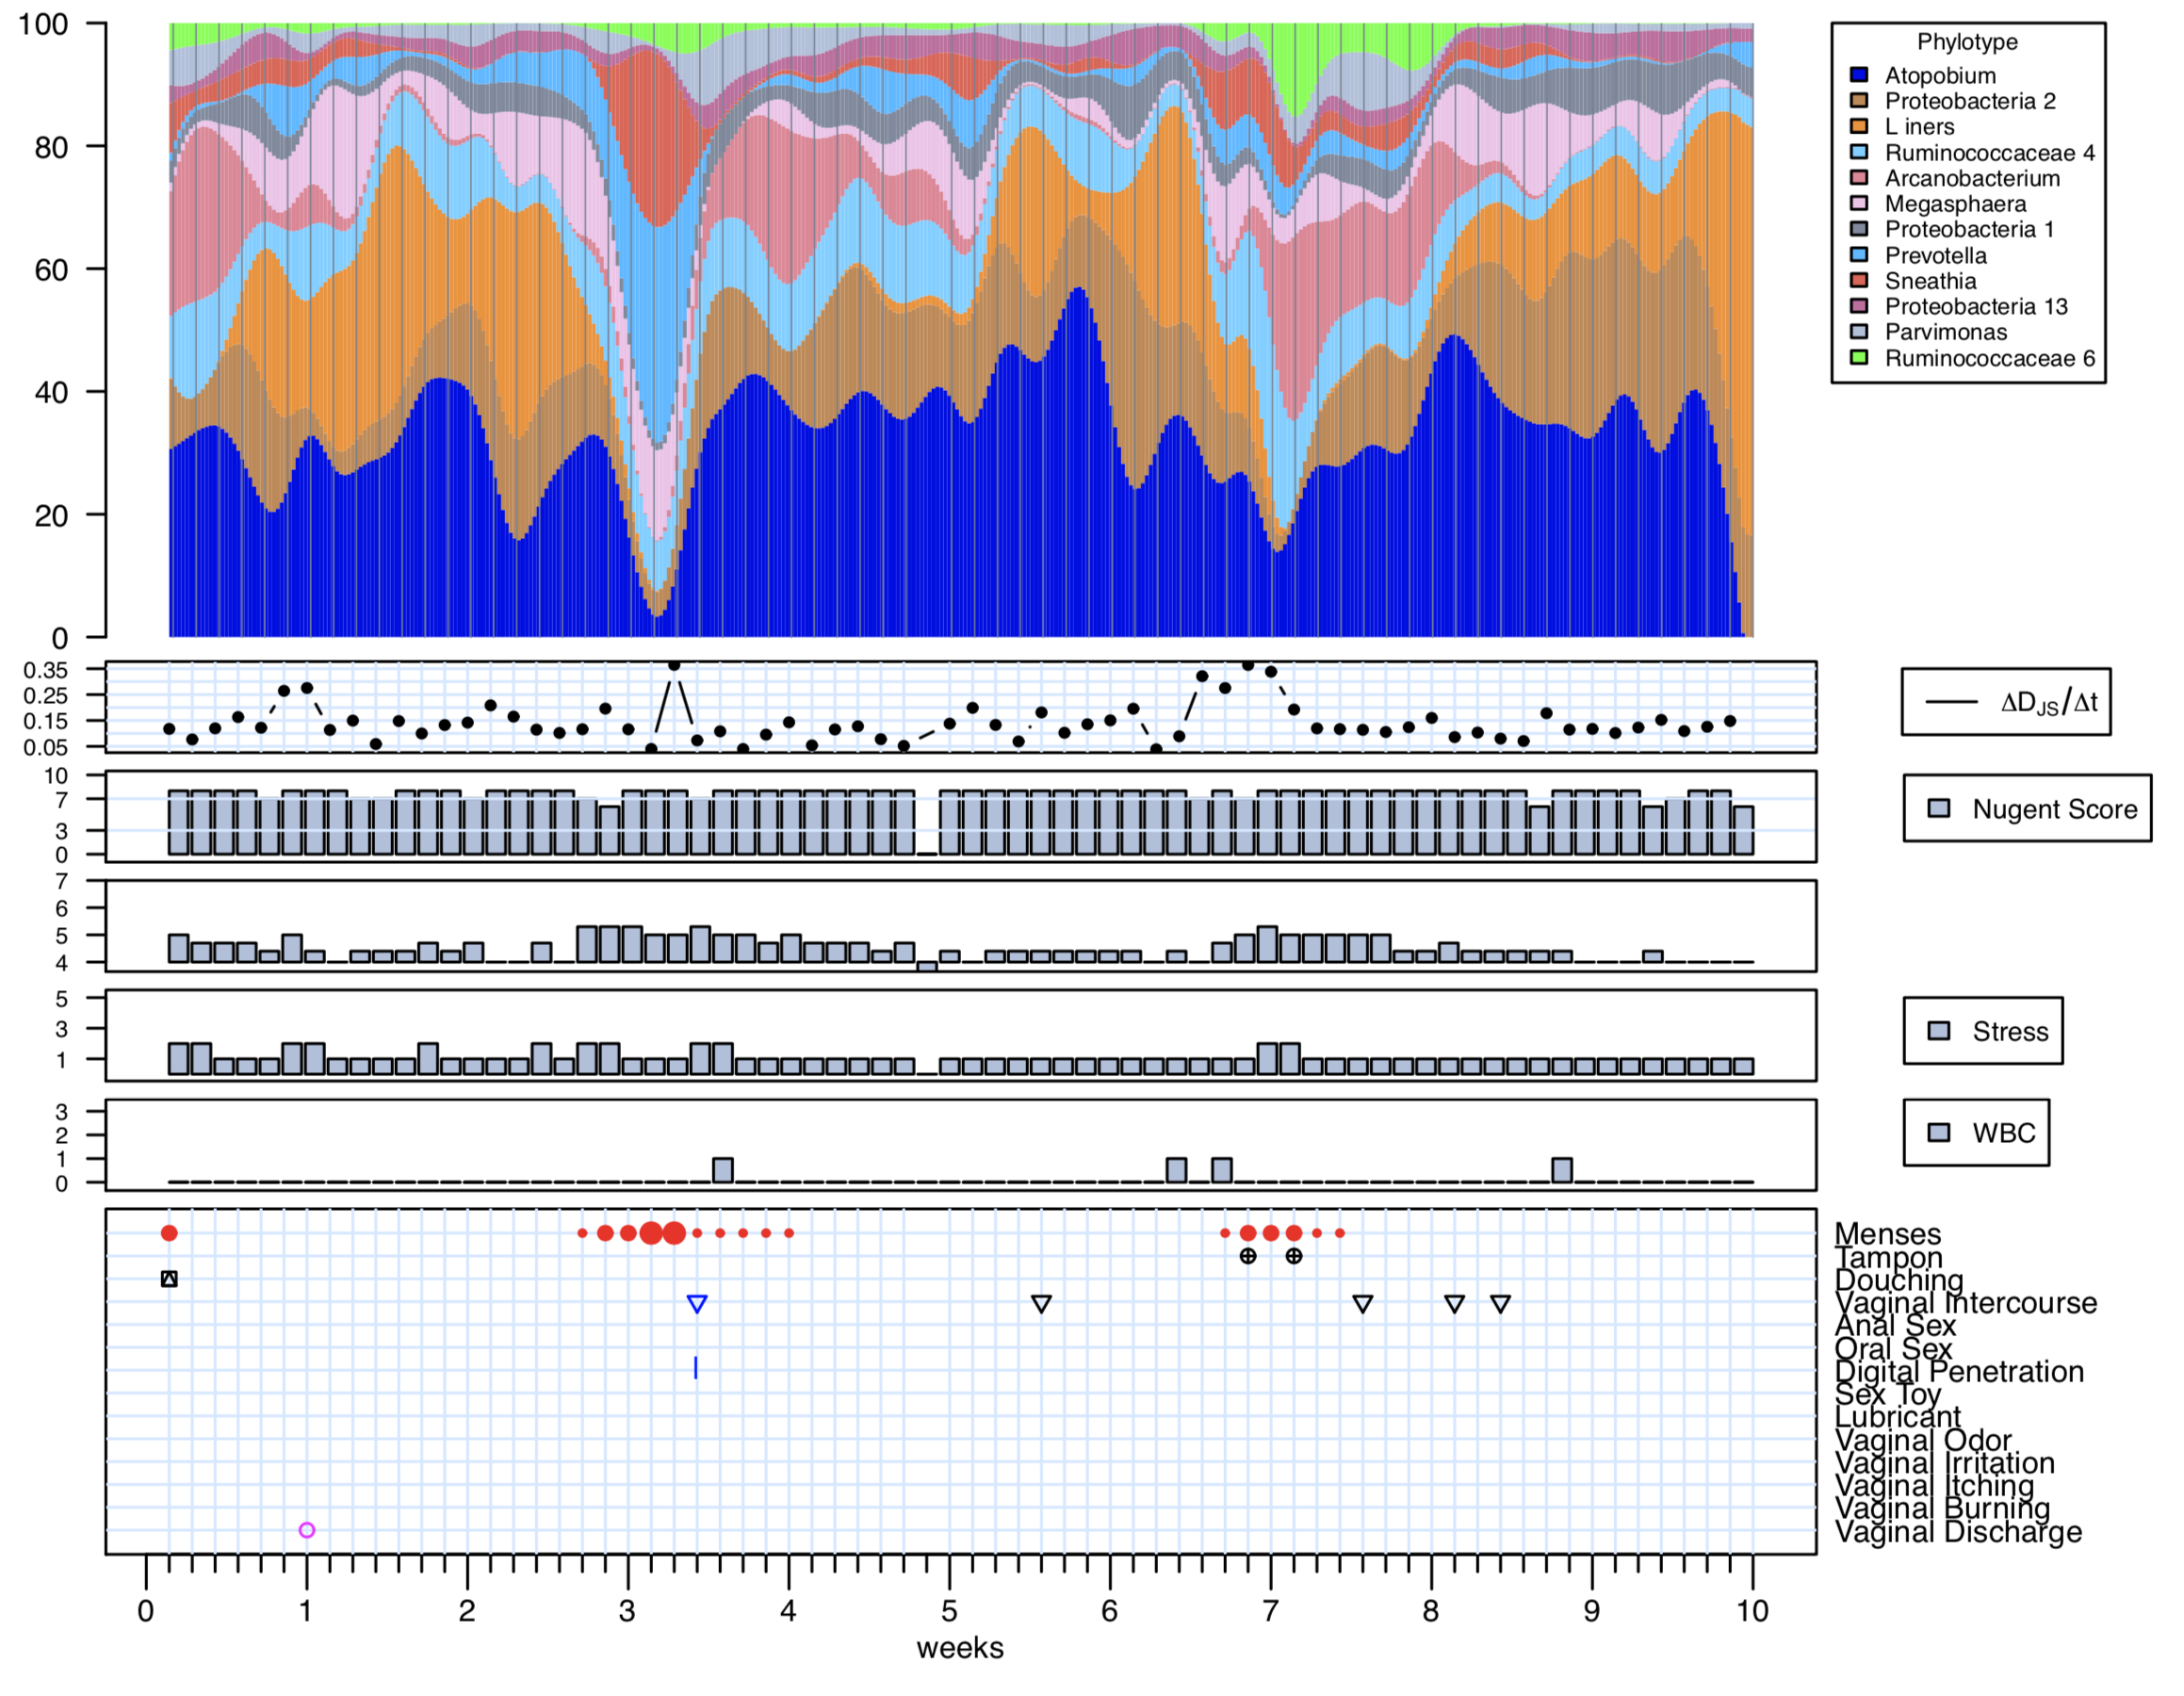
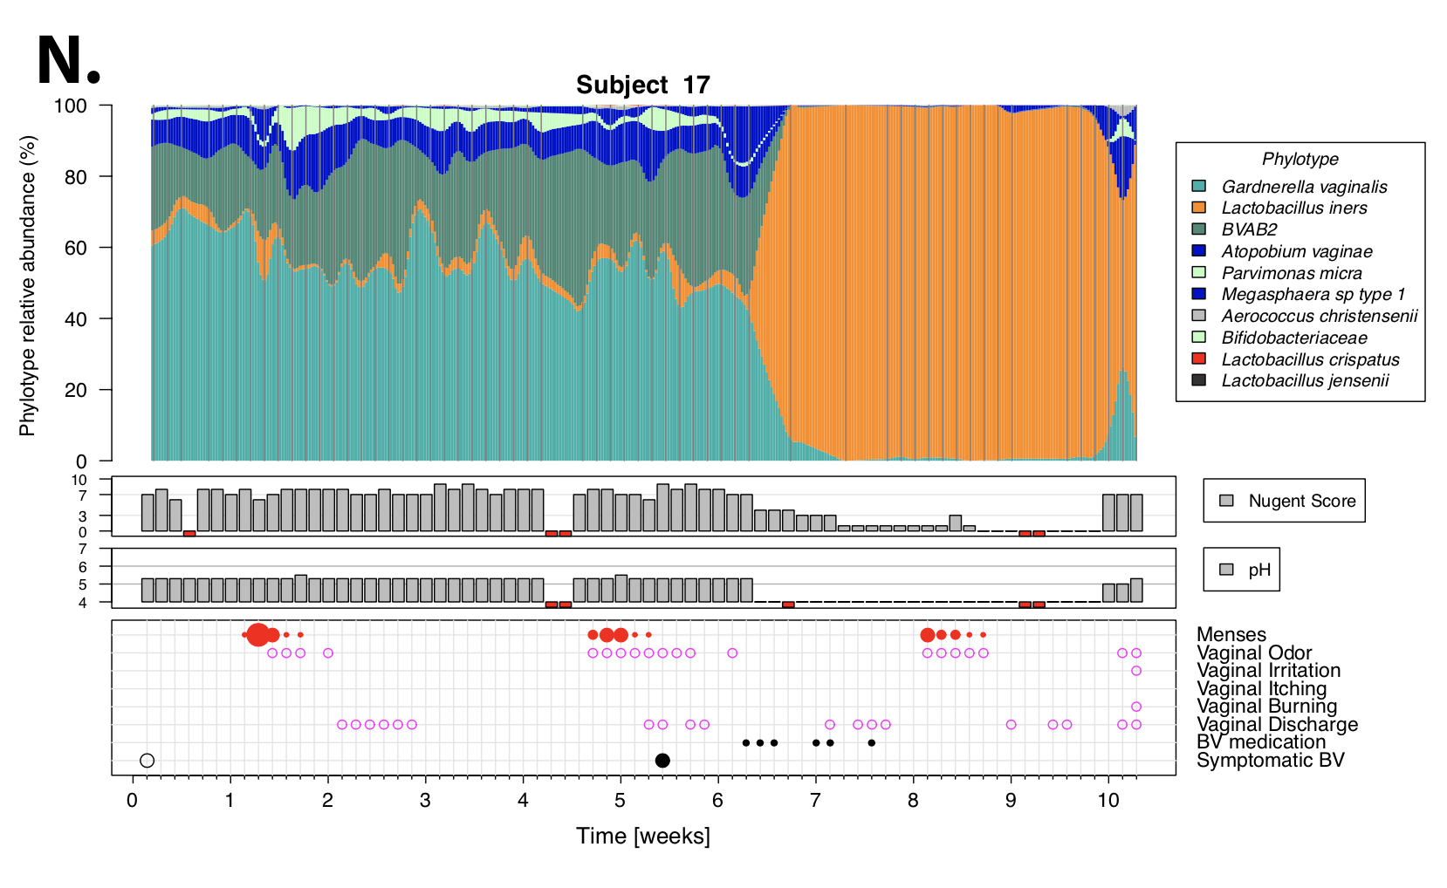
The dynamics of the vaginal microbiota

Slide 17
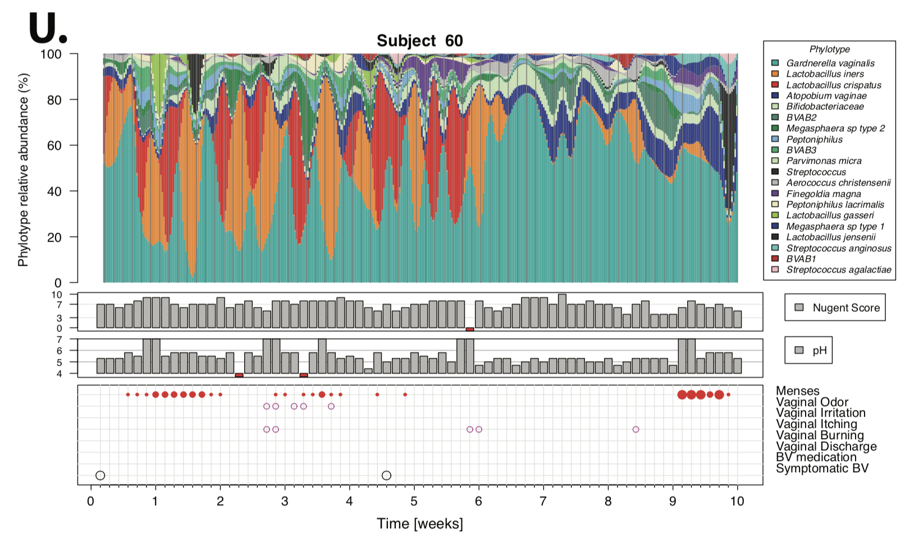
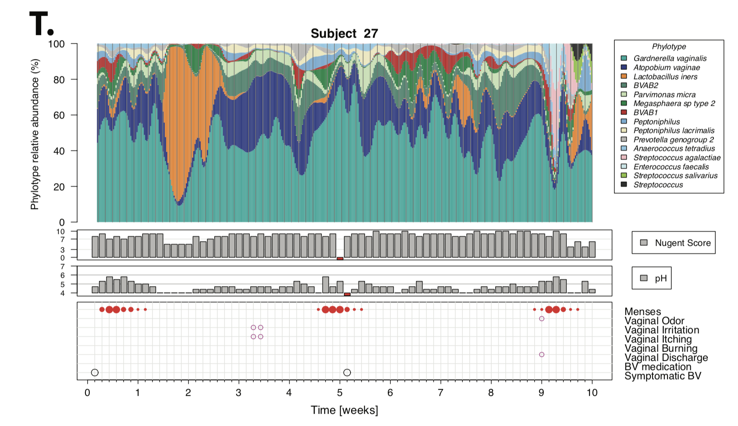
The dynamics of the vaginal microbiota

Slide 18
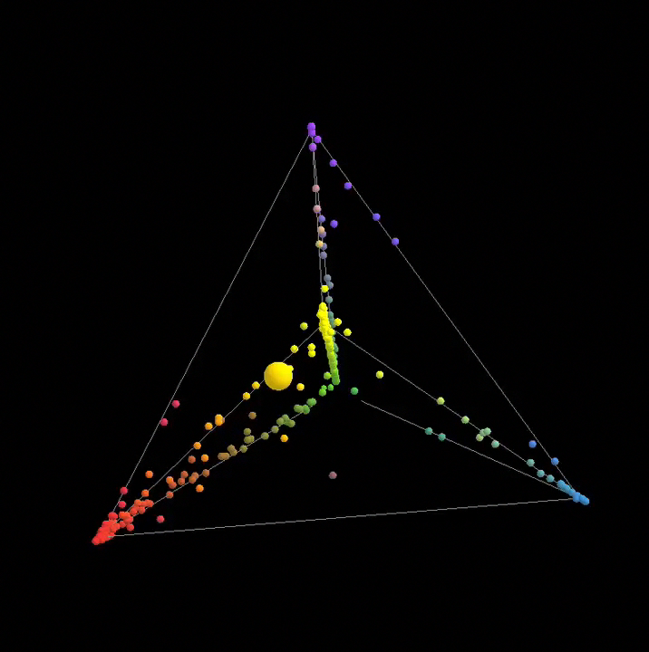
The dynamics of the vaginal microbiota

Slide 19
Adverse outcomes associated with CST IV types microbiota
Gynecologic
Pelvic inflammatory disease (PID)
Acquisition of STIs – HSV-2, HIV, Chlamydia, UTI…
Cervical cancer
Morbidity –vaginal discharge and malodor
Reproductive
Endometriosis, Myomatosis, Hyperplasia, Polyposis…
Endocervical cancer
Difficulty to conceive
ART failure
Obstetric
Preterm delivery and low birth weight
Postpartum endometritis
Amniotic fluid infection
Chorioamnionitis
Whether associated with symptoms or not, non-optimal vaginal microbiota carry many risks:

Slide 20
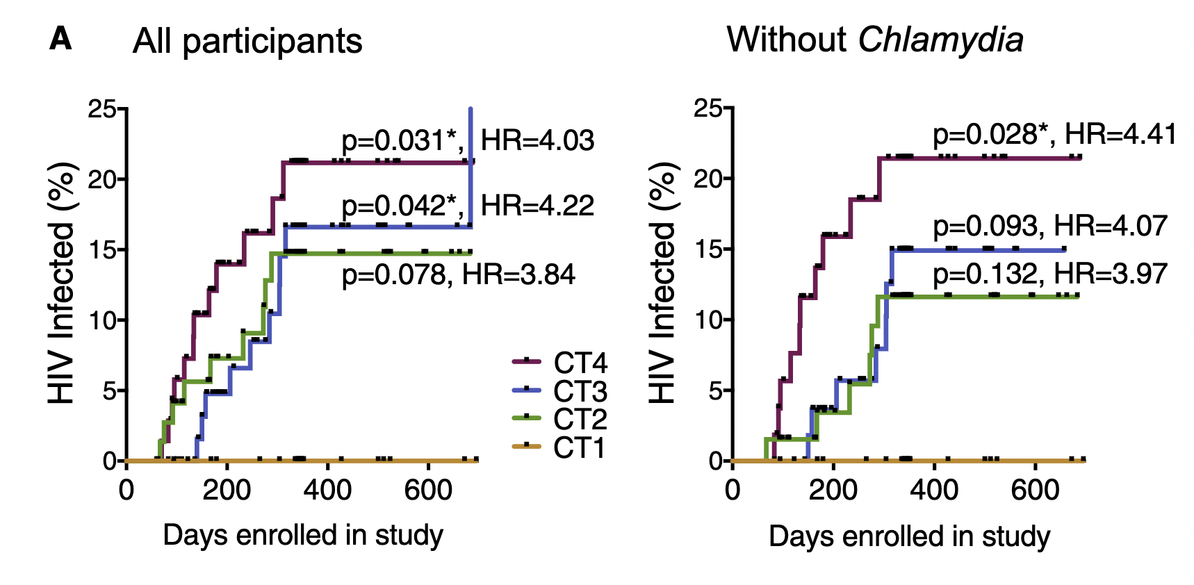
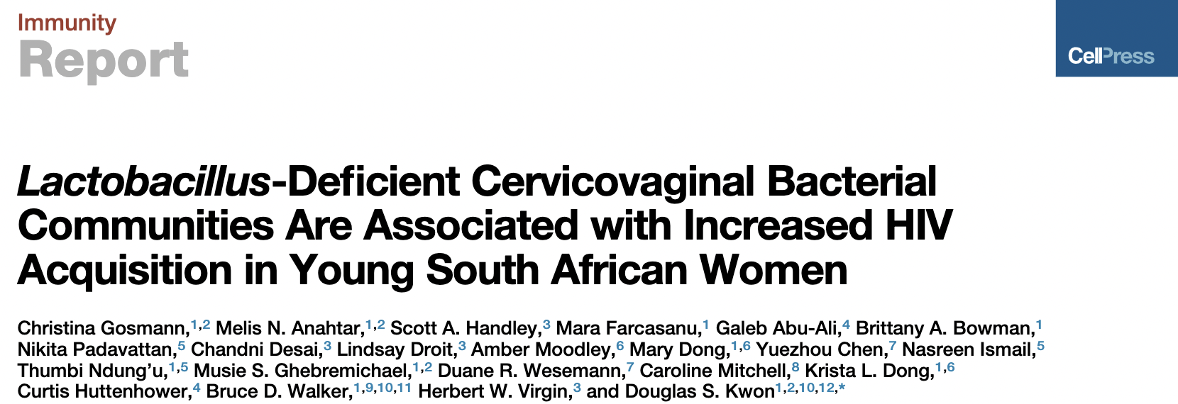
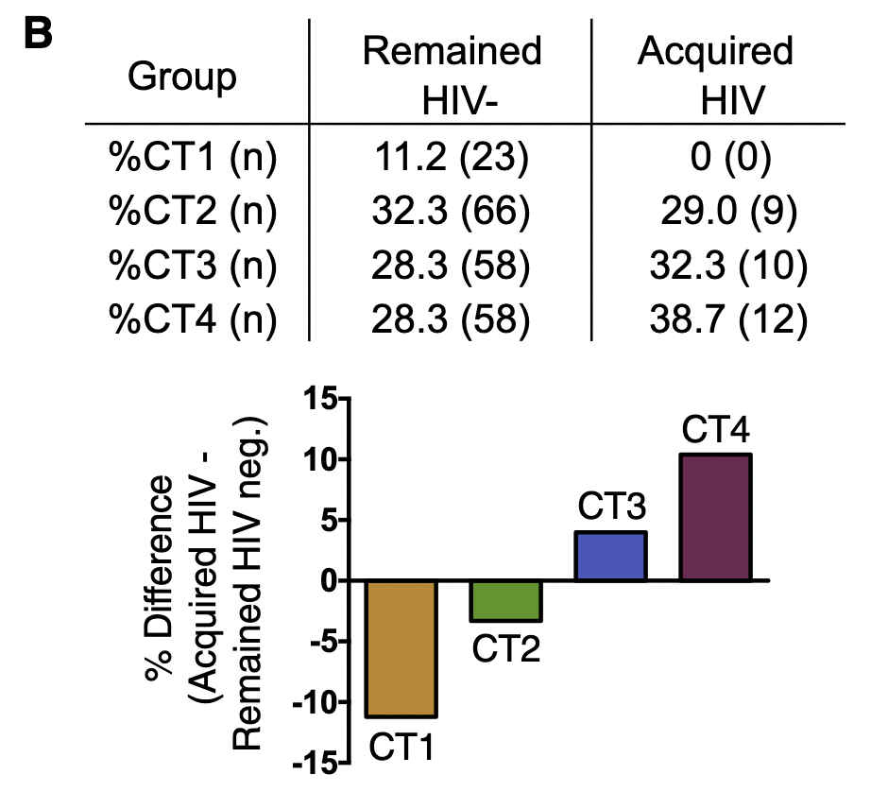
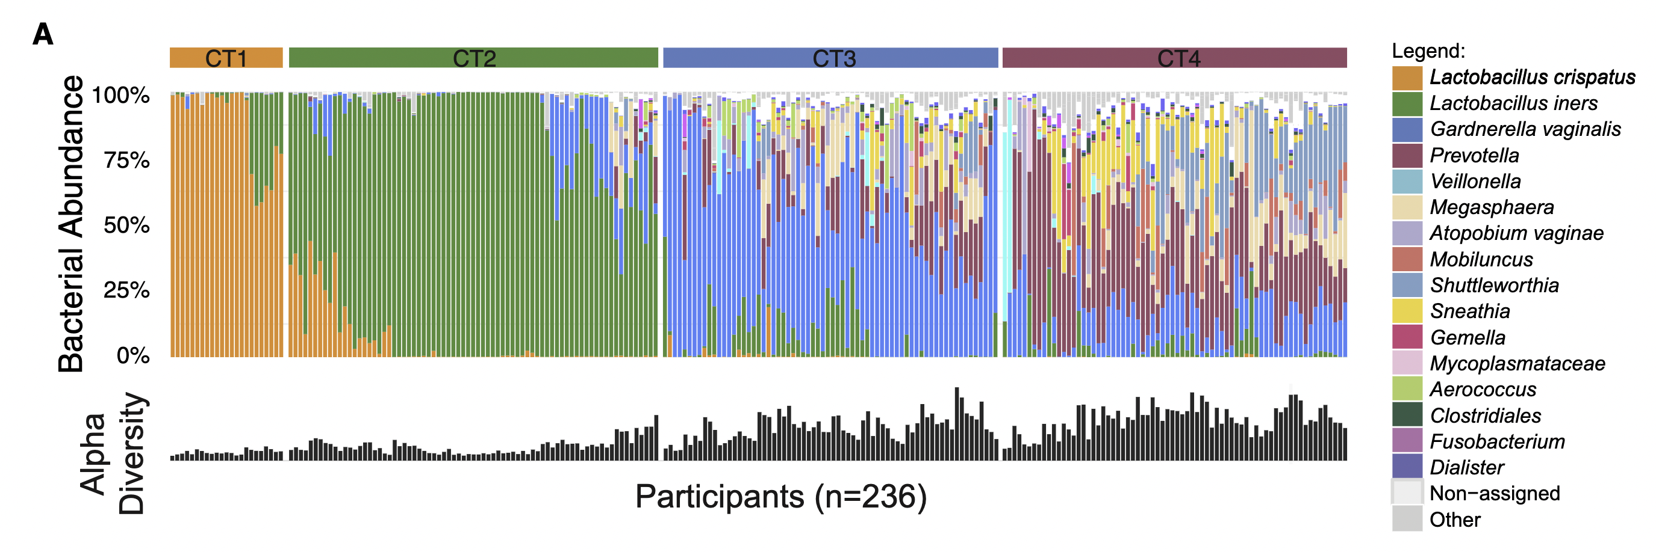
L. crispatus-dominated microbiota tend to be optimal

Slide 21
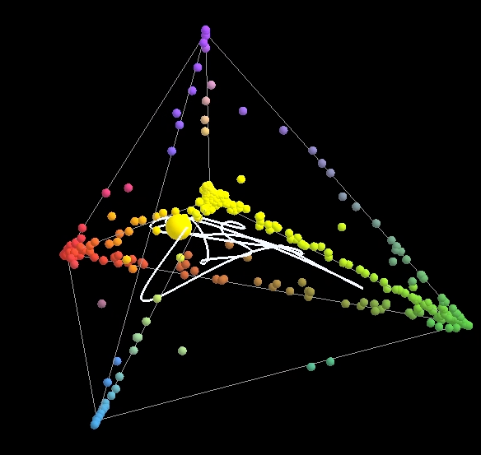
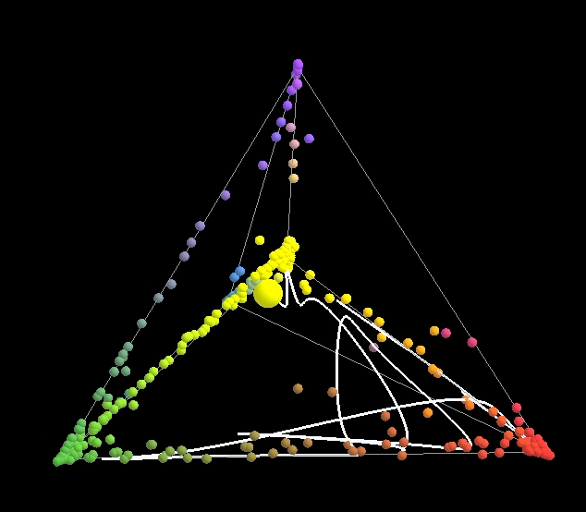
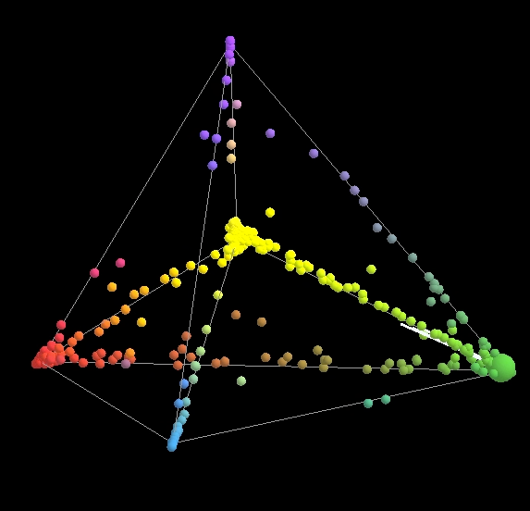
The dynamics of the vaginal microbiota and risk of adverse outcomes
There are windows of higher risk that open and close on a temporal scale
The dynamics of the vaginal microbiota (frequency and duration of CST IV events) better represents the risk of adverse outcomes.

Slide 22
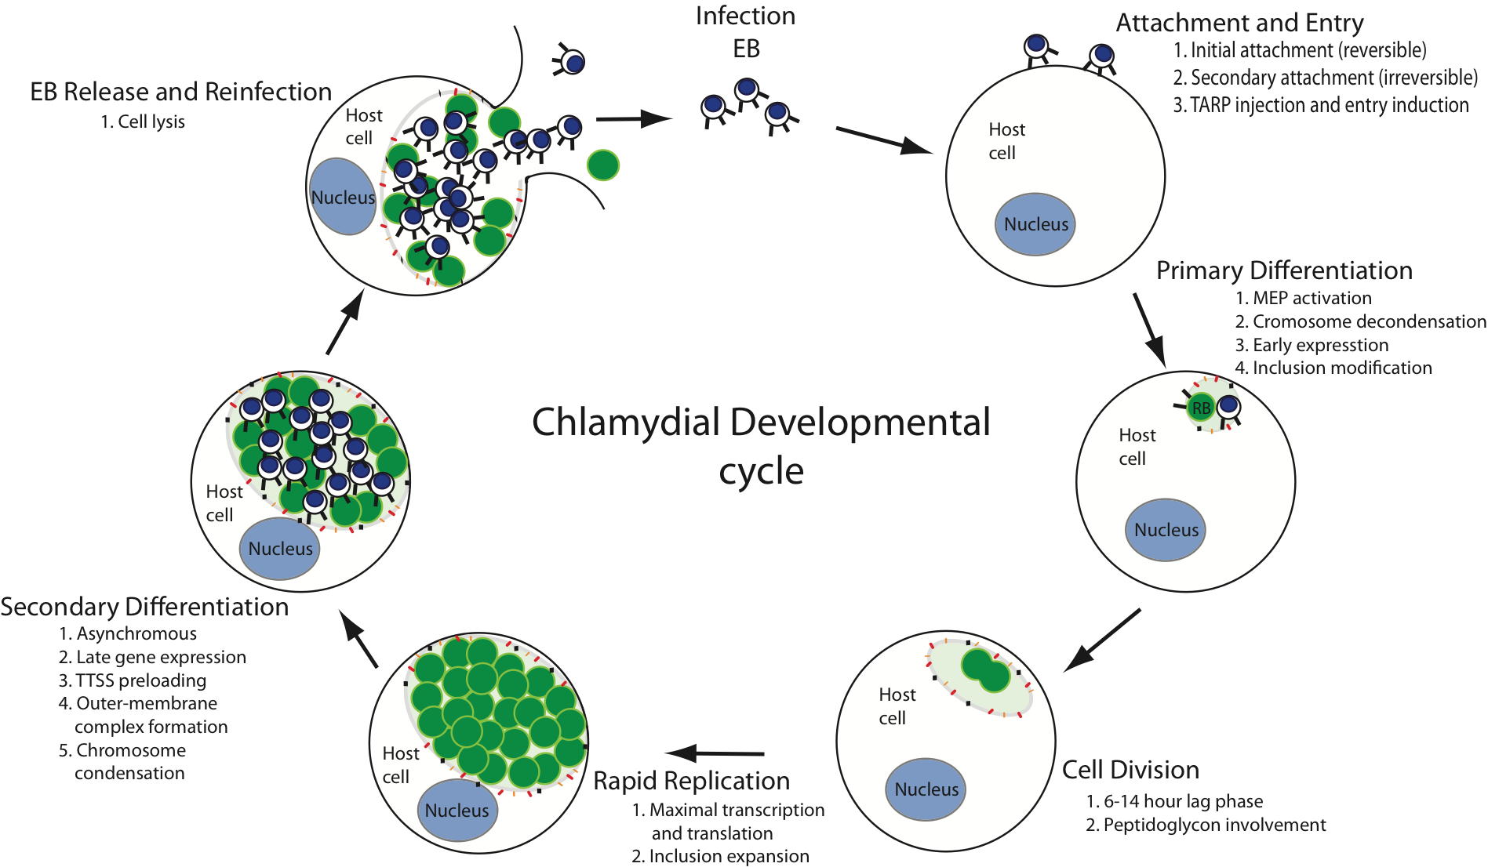
Chlamydia trachomatis
The rate of infection after a sexual contact with an infected partner by C. trachomatis is estimated at 25-40%

Slide 23
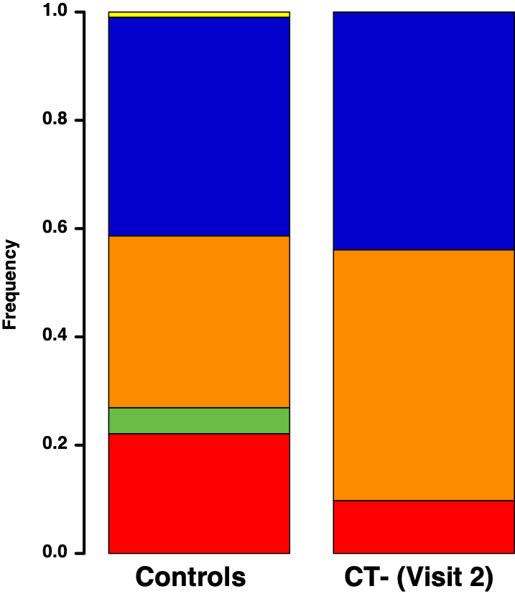
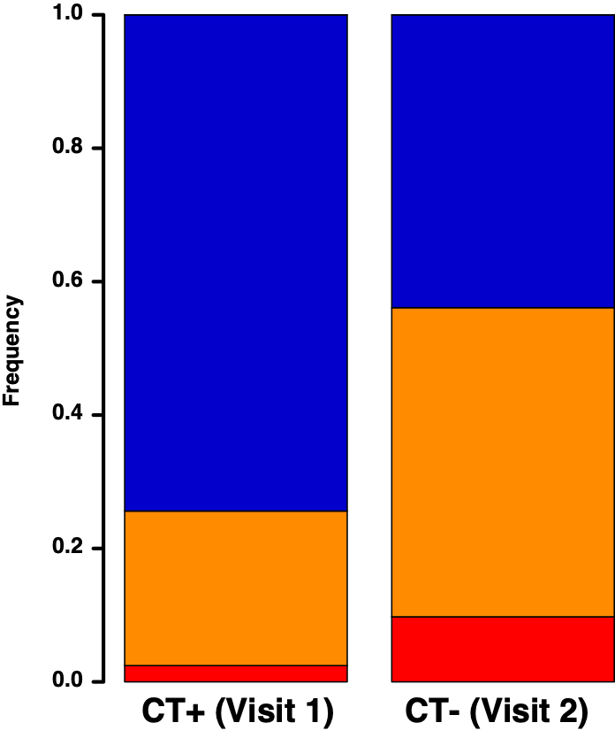
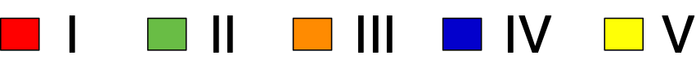
The vaginal microbiota and Chlamydia trachomatis infections
150 CT+ women
Azithromycin treatment
Resampled 3 months later
**
**
CST:

Slide 24

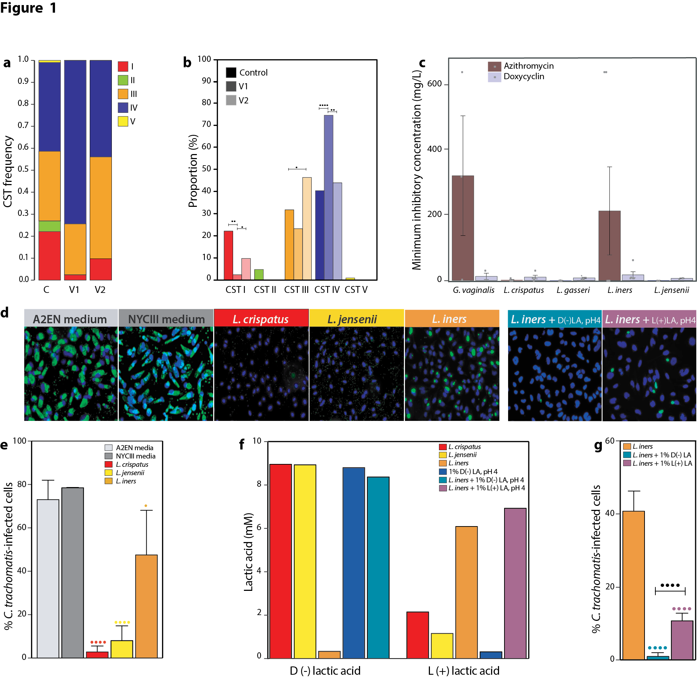
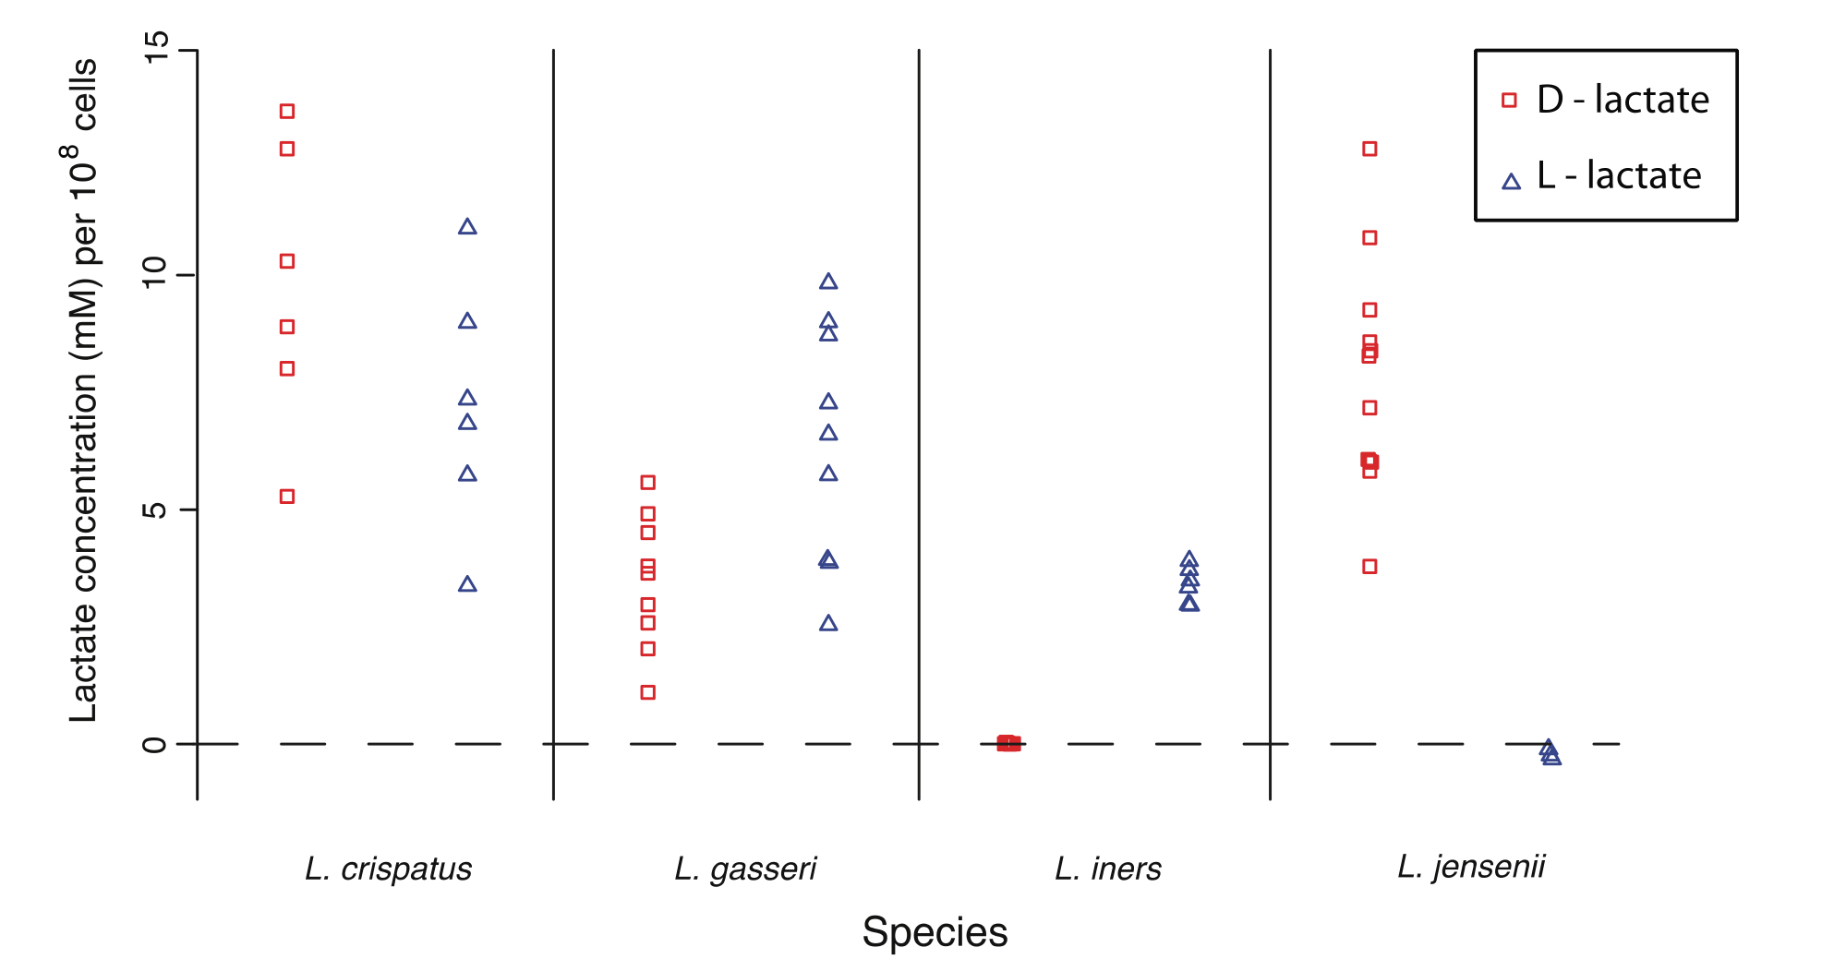
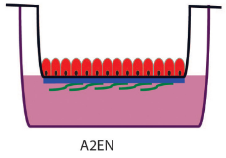
Lactobacillus spp. differentially affect C. trachomatis in vitro infection
Vonetta Edwards
Edwards VL, et.al. mBio 10(4) (2019)
Edwards VL, et al. Pathogens and Disease 80, ftac026 (2022)

Slide 25
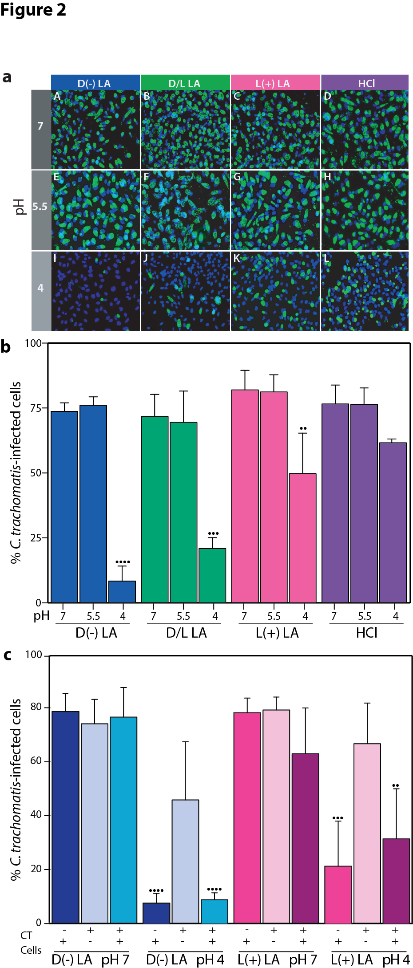
Lactic acid does not directly affect C. trachomatis

Slide 26
Lactobacillus spp. differentially affect C. trachomatis in vitro infection
30 min. exposure

Slide 27
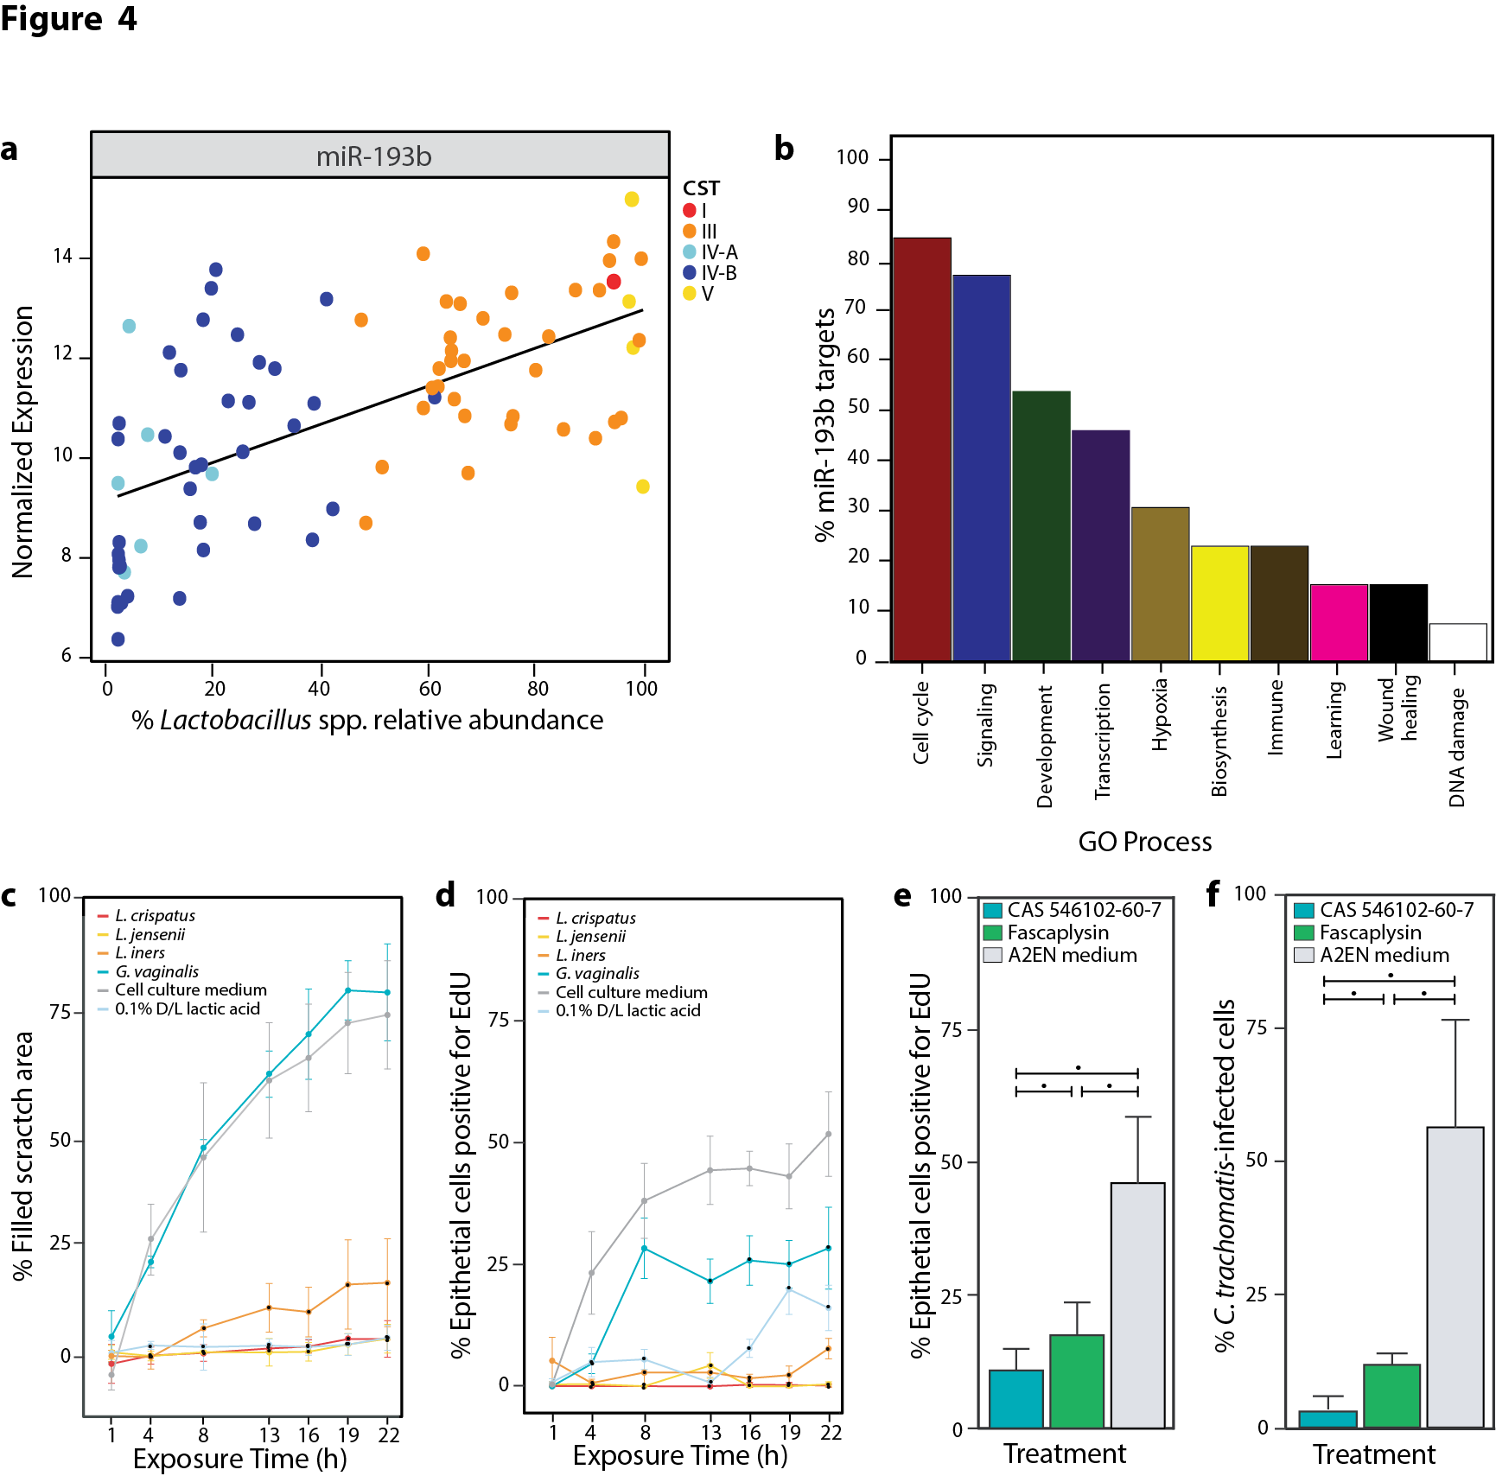
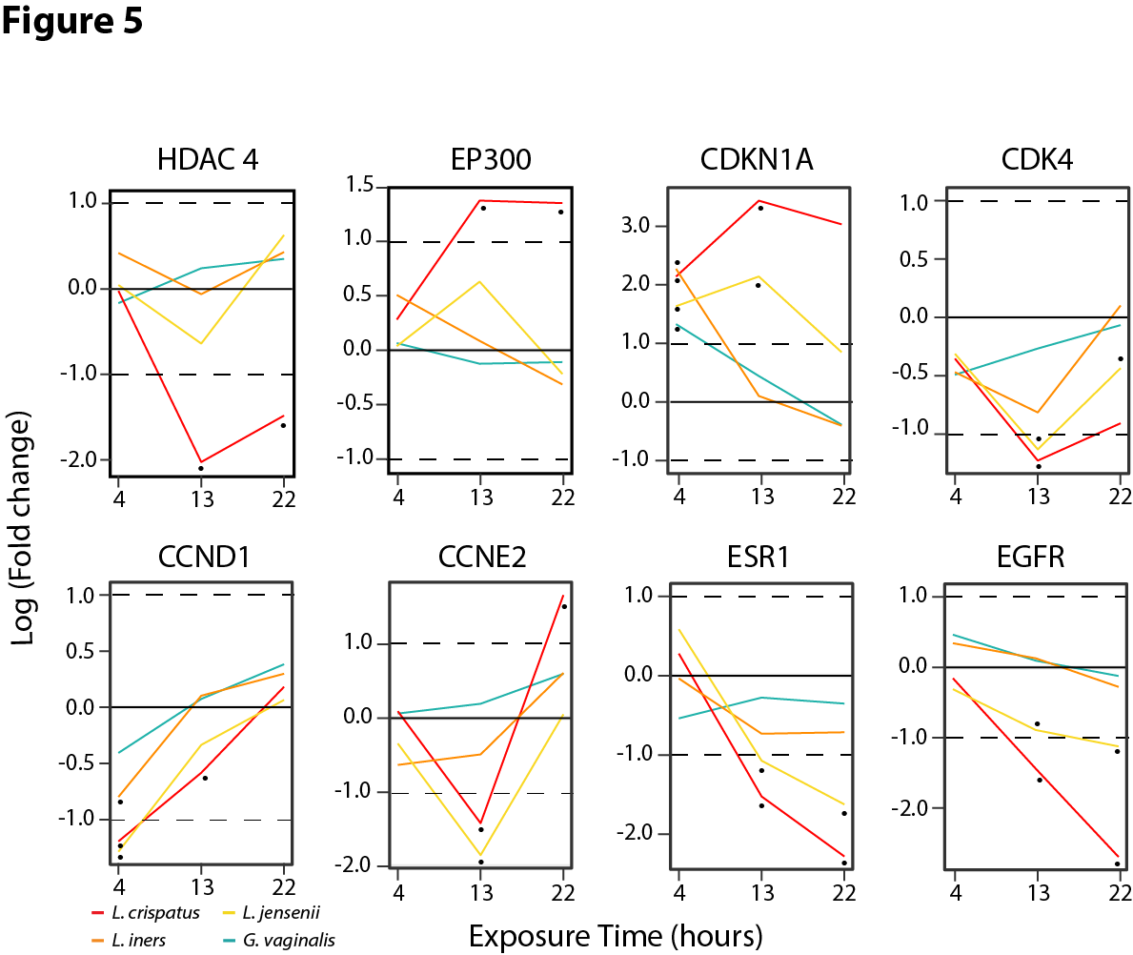

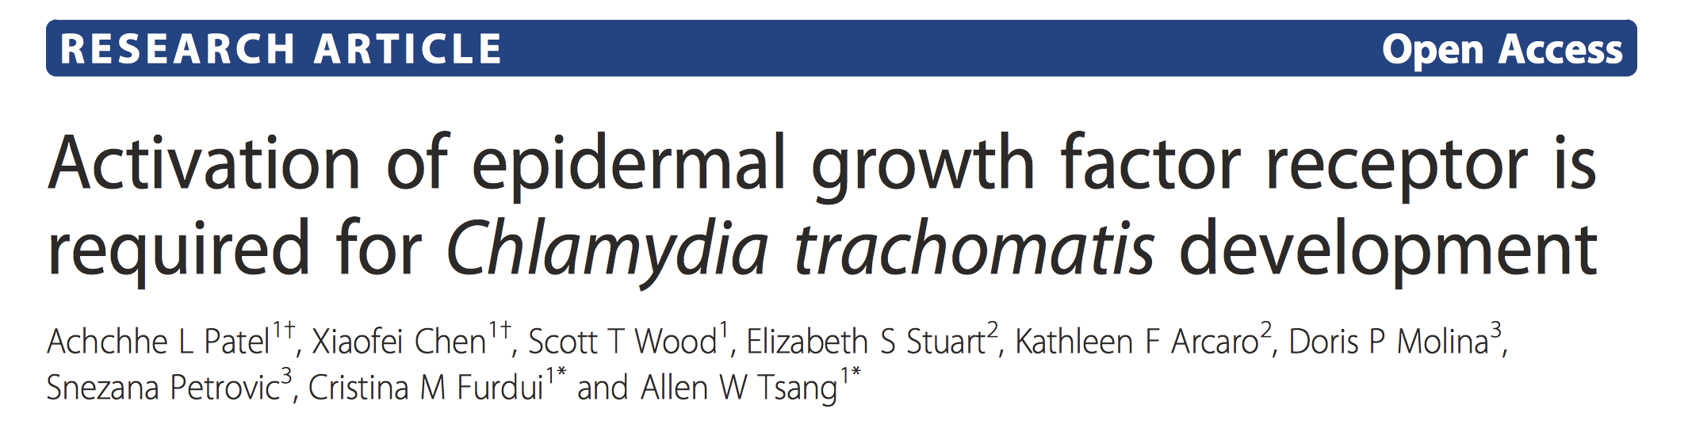
Epigenetic modulation of the cell cycle by the vaginal bacteria
HDAC 4
CDKN1A
Cell Cycle
HDAC 4
CDKN1A
Cell Cycle

Slide 28
Epigenetic modulation of the cell cycle by the vaginal bacteria

Slide 29
Lactobacillus spp. differentially affect C. trachomatis in vitro infection
30 min. exposure
Exposure to different Lactobacillus species and strains can prevent and resolve chlamydial infection

Slide 30
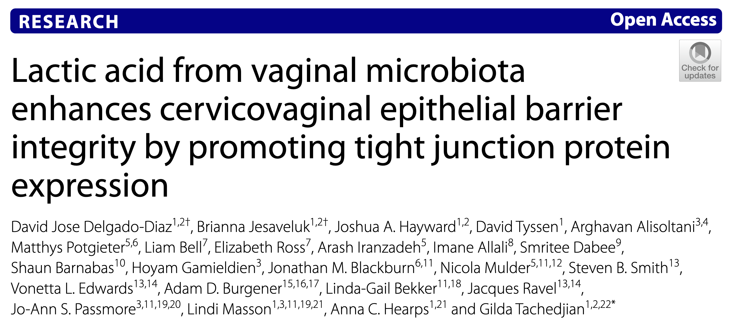




Properties of lactic acid produced by the vaginal microbiome
• High D-lactic acid concentration explains trapping of HIV particles in mucus
• pH, Nugent score, total lactic acid did not explain trapping or mobility
Delgado-Diaz, D. J. et al.. Microbiome 10, 141 (2022).
Nunn, K. L. et al. MBio 6, e01084-15 (2015).
Hearps, A. C. et al. Mucosal Immunol 941, 21 (2017).

Slide 31


Treatment for cervicovaginal conditions, where are we now?
Progression of treatment for bacterial vaginosis
60% recurrence
1960’s
1980’s
2000’s
2020’s
Triple sulfa
cream
Nitroimidazole
Clindamycin
Nitroimidazole
Clindamycin
Nitroimidazole
Clindamycin
Slide courtesy of Caroline Mitchell

Slide 32
New therapeutics to cure and prevent infection/diseases
There is a need for antibiotic-sparing live biotherapeutic drugs to modulate the composition and function of the vaginal microbiota with the intent to restore an optimal microbiota to cure and prevent infection/diseases.
A vaginal microbiome-based therapeutics should at least be administered vaginally as they intend to modify the composition (colonization) and function of the vaginal microbiome to exert their effect.
Thus, from a regulatory standpoint, microbiome-based LBPs will be regulated as drugs, and undergo rigorous clinical trial and obtained regulatory authorization

Slide 33



Live Biotherapeutics Products (LBP) development
Lactin-V:
Single species
Single strain
Vaginal Microbiota Transplant:
Dominant species
Whole community
Multi-strain LBP:
Single species Multiple strains

Slide 34
Live Biotherapeutics Products (LBP) development
Lactin-V:
Single species
Single strain
Vaginal Microbiota Transplant:
Dominant species
Supporting community
Multi-strain LBP:
Single species Multiple strains

Slide 35


Metagenomics exploration of the vaginal microbiome functions
virgo.igs.umaryland.edu
• 2,560 metagenomes
• 15,221 genomes

Slide 36


Within women intraspecies diversity
Under dominance of a single Lactobacillus species, multiple strains co-exist and there is a high within-community intraspecies diversity.
Assemblages of con-specific genotypes (strains of the same species) in vaginal microbiomes
Number of non-redundant genes
Intraspecies diversity affords functional redundancy
Genomes
Metagenomes

Slide 37
Functional redundancy
F1, F2,F3
F1, F3, F4
F1, F3, F4
F1, F4
F1, F3, F4
F2,F3,F5
F1,F4,F6
F1, F3, F4
F1, F3, F4
F3,F5, F6
F4,F6
F1, F3, F4

Slide 38
Functional redundancy
F1, F2,F3
F1, F3, F4, F10
F1, F3, F4, F12
F1, F4
F1, F3, F4, F6
F2,F3,F5
F1,F4,F6
F1, F3, F4, F8
F1, F3, F4, F8, F9
F3,F5, F6
F4,F6
F1, F3, F4, F9

Slide 39


Metagenomic subspecies – Define by gene content
Con-specific genotypes assemblages (metagenomic subspecies) differ in the genetic content of the encompassing strains.
The overall functional content of the assemblages are different.
LI1
LI2
LI3
LI4
Lactobacillus iners non-redundant genes (n=5,474)
.Holm, J. B. et al. Integrating compositional and functional content to describe vaginal microbiomes in health and disease. Microbiome 11, 259 (2023).
Notes:
Functionally and taxonomically annotated non-redundant gene catalogue – used as reference in our analyses

Slide 40






Metagenomic CST (mgCST) – Taxonomic and functional dimensions drive community structure
•••
Prevotella bivia
PB1
PB2
PB3
PB4
Lactobacillus jensenii
LJ1
LJ2
LJ3
Lactobacillus iners
LI1
LI2
LI3
LI4
Lactobacillus gasseri
LG1
LG2
LG3
Gardnerella vaginalis
GV1
GV2
GV3
GV4
Lactobacillus crispatus
LC1
LC2
LC3
LC4
LC5
LC6
LC7
Sample 1
Sample 2
A metagenomic CST represents a group of vaginal microbiomes that harbor a similar combination of metagenomic subspecies (thus defined by both species and gene content)
.Holm, J. B. et al. Integrating compositional and functional content to describe vaginal microbiomes in health and disease. Microbiome 11, 259 (2023).
Notes:
Functionally and taxonomically annotated non-redundant gene catalogue – used as reference in our analyses

Slide 41


Metagenomic CST (mgCST) – Susceptibility to STI
OR 2.70
95% CI: 1.6-6.0
OR 2.22
95% CI: 1.2-4.5
OR 1.98
95% CI: 1.2-4.0
OR 2.2
95% CI: 1.2-4.2
OR 3.6
95% CI: 1.8-8.2
OR 2.3
95% CI: 1.1-5.1
OR 2.3
95% CI: 1.1-5.5
Reduced ODDS
Reduced ODDS
Increased ODDS
Reduced ODDS
Increased ODDS
Increased ODDS
Holm et al. (2024). unpublished
Notes:
Functionally and taxonomically annotated non-redundant gene catalogue – used as reference in our analyses

Slide 42



Biogeography of the vaginal L. crispatus
L. crispatus lineages display biogeographic patterns, with some appearing endemic to certain geographic locales and others displaying more cosmopolitan ranges
Genome SNP tree of 81 worldwide L. crispatus lineages represented in VIRGO2

Slide 43
Leveraging knowledge to develop microbiome-based vaginal LBPs
Microbiome-based LBPs should include multiple strains (of L. crispatus) or even multiple species and might need to be developed considering local biogeography for optimal efficacy.
Selected strains should be associated with stable vaginal microbiota, have beneficial properties, have beneficial genotypic characteristics, and potentially geo-adapted to the target population
Consortia should encompass the genetic diversity comprised in stable and optimal vaginal microbiota to maximize functional properties

Slide 44




The Bill and Melinda Gates Foundation Vaginal Microbiome Research Consortium
Goal: Develop an innovative Live Biotherapeutic Products for bacterial vaginosis/CST IV to ultimately reduce the risk of reproductive and gynecological adverse outcomes in Africa and South Asia.

Slide 45

Design approach: multiple strains consortium
Use the information to design a vaginal live biotherapeutic product that comprise of multiple con-specific genotypes of Lactobacillus crispatus.
Ma, B. et al. (2020). Nature Communications, 11(1), 940–13.

Slide 46

Multi-strain consortia may adapt to differences in host response

Slide 47

Building microbiota-informed live biotherapeutics
The algorithm generated several candidate consortia of 6 L. crispatus strains

Slide 48

Considering biogeography

Slide 49

Building microbiota-informed live biotherapeutics
Antimicrobial Assays – Consortium Selection

Slide 50



Manufacturing a microbiota-informed live biotherapeutics
Two cGMP formulations have been manufactured:
A 6-strain (LC106) and a 15-strain (LC115) formulations:
1 g mucoadhesive pills
Disintegration time is 5-6 hours
Packaged into blister packs
Delivered with an applicators

Slide 51

Clinical Trial for the Prevention of Recurrent Bacterial Vaginosis

Slide 52

VIBRANT Clinical Trial Design
Screening
0d
1w
2w
3w
4w
5w
7w
9w
12w
Placebo
ABX
Daily 7d
Off product follow-up
Extended follow-up
LC-106
ABX
Daily 7d
Off product follow-up
Extended follow-up
LC-106
ABX
4d
Off product follow-up
Extended follow-up
3d
ABX
Off product follow-up
Extended follow-up
LC-106
Daily 7d
LC-115
ABX
Daily 7d
Off product follow-up
Extended follow-up
= in person weekly visit with swabs, menstrual cup sampling, questionnaires
= daily home swabs

Slide 53












VIBRANT Clinical Trial Sites
Clinical site
Lab site
DCC
N = 50
Disebo Potloane
Sinaye Ngcapu
JoAnn Passmore
Lenine Leibenberg
Caroline Mitchell
Doug Kwon
Nomfuneko Mafunda
N = 50
Laboratory Sites: University of Maryland School of Medicine, MGH

Slide 54
Other considerations: Nomadic Lactobacillus species
Lactobacillus-dominated vaginal microbiota are often associated with ”nomadic” Lactobacillus.
These Lactobacillus species also show biogeographical distribution.

Slide 55

Other considerations: Supportive chemistry and prebiotic
Strategy to maximize colonization might include the addition of prebiotic (nutrients favored by the LBP strains/prebiotic) and supportive chemistry to prepare the microenvironment and favor the growth of the LBP strains

Slide 56
Conclusions
We need innovation in the development of live biotherapeutic products with established clinical efficacy to restore Lactobacillus crispatus dominance and address major reproductive, obstetric and gynecological outcomes associated with CST IV types of microbiota.
Several initiatives (academic or private) are ongoing. There are reasons to be optimistic!
These products will need to be tested through rigorous and well-powered clinical trials (Phase 1 through 3) and obtain regulatory (FDA/EFSA…) approval.
We need to continue innovating until optimal solutions are identified that finally provide women ways to optimize their vaginal microbiota and protect themselves.

Slide 57











Acknowledgments
Mike Humphrys
ravel-lab.net
Disebo Potloane
Sinaye Ngcapu
JoAnn Passmore
Lenine Leibenberg
Caroline Mitchell
Doug Kwon
Nomfuneko Mafunda
Bing Ma
Michael
France
Pawel
Gajer
Vonetta Edwards
Lindsay Rutt
Bern Monari
Breanna Shirtliff
Christina Barrett
Sarah Brown
Melanie Quain
Maddy Alizadeh
Issac Chaudry
Amaury Maros
Kayla Carter
https://github.com/ravel-lab/speciateIT
Johanna Holm

Slide 58
Exploring and translating the female genital tract microbiota
Questions?

